Slide 1

Advanced Sacred Comms
Communication Coaching
CH (MAJ) Brandon Moore
Homiletics SME, USACHCS
29 April 2015

Slide 2
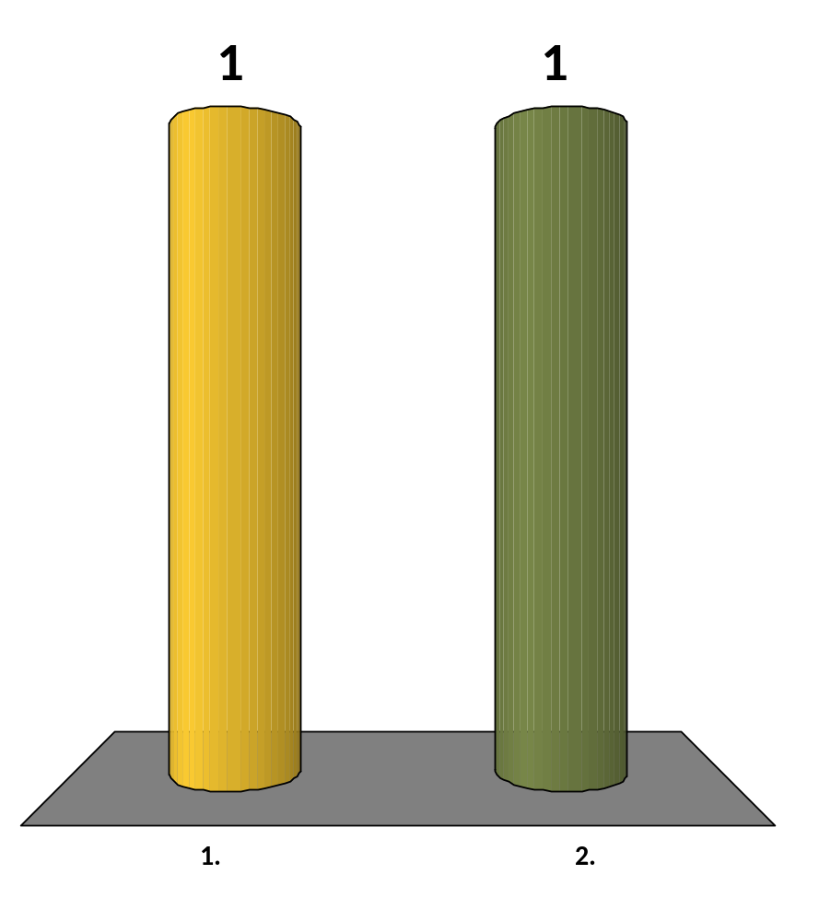
I am a ________.
LTC
COL

Slide 3
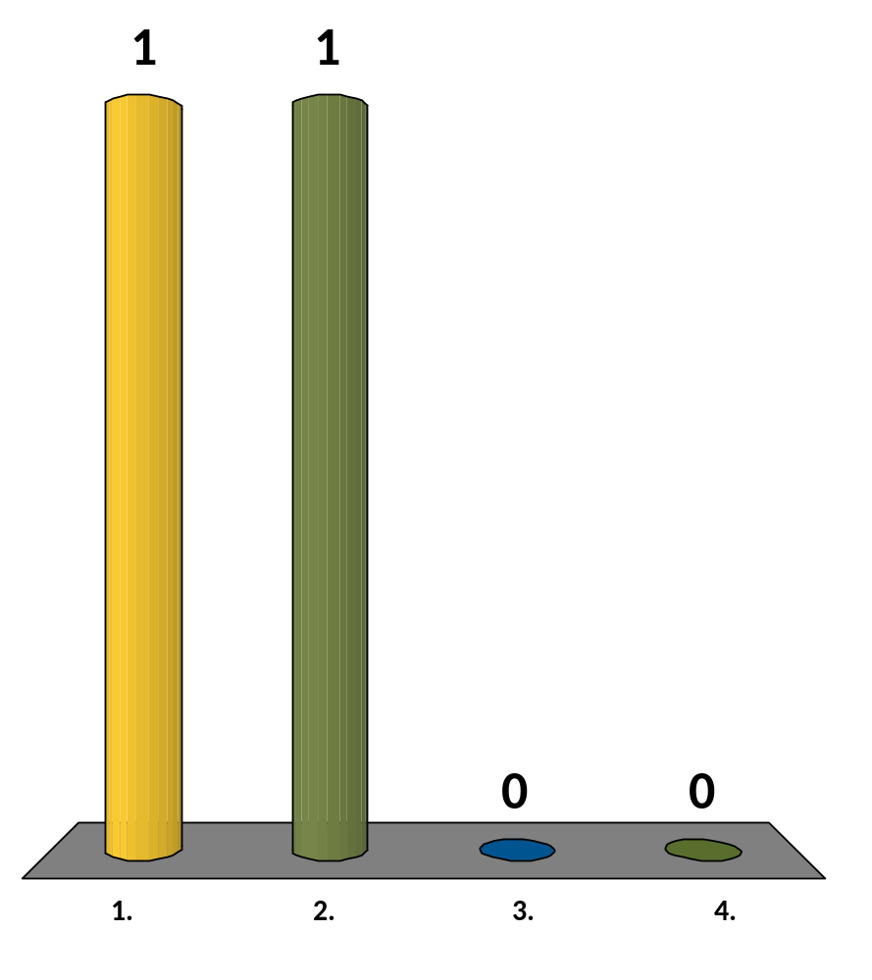
filament : light bulb :: wick :
candle
wax
broom
jar

Slide 4
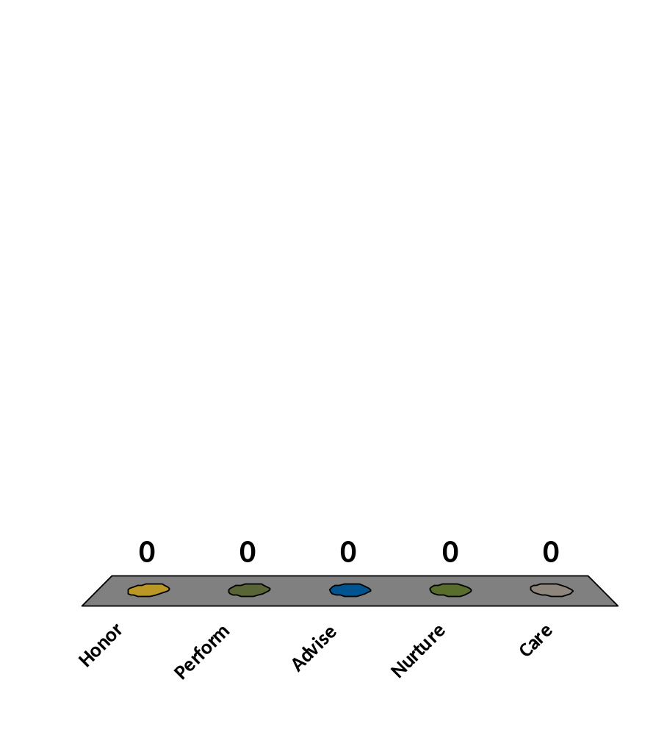
Chaplain CorE Competencies Are:
(List all that apply)
Honor
Perform
Advise
Nurture
Care

Slide 5
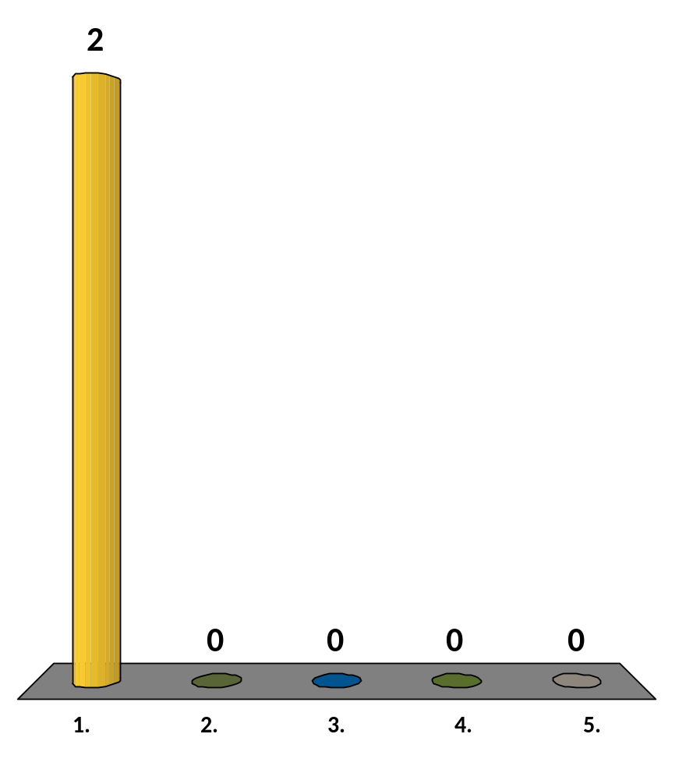
The Army’s Basic WarFighting Doctrine is. . .
Full Spectrum Ops
Unified Land Ops
Decisive Action
Black Ops
None of the Above

Slide 6
A Subordinate Chaplain has complete confidentiality with His/her Supervisory Chaplain?
True
False

Slide 7
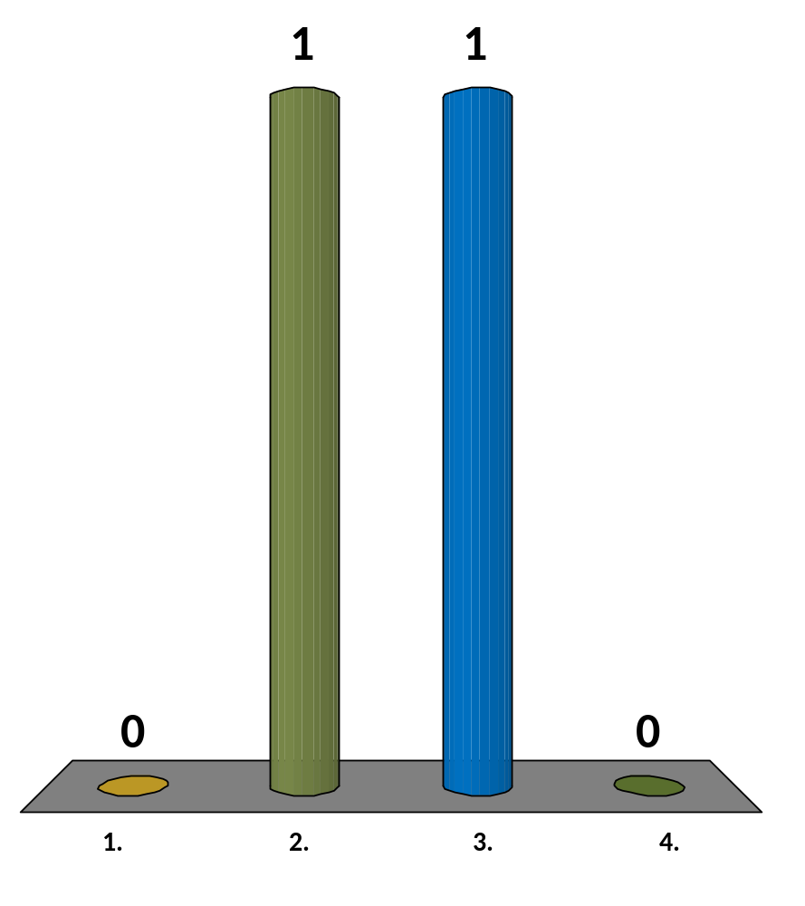
C_A_L_I_
P I N Q
Q E K P
A H P N
P U S D

Slide 8
Team Scores
Points | Team | Points | Team
50 | LTC
35 | COL

Slide 9
Fastest Responders
Seconds | Participant | Seconds | Participant
1.81 | 10620B

Slide 10
What percentage of your current points would you like to wager on the next question?
0%
25%
50%
75%
100%

Slide 11
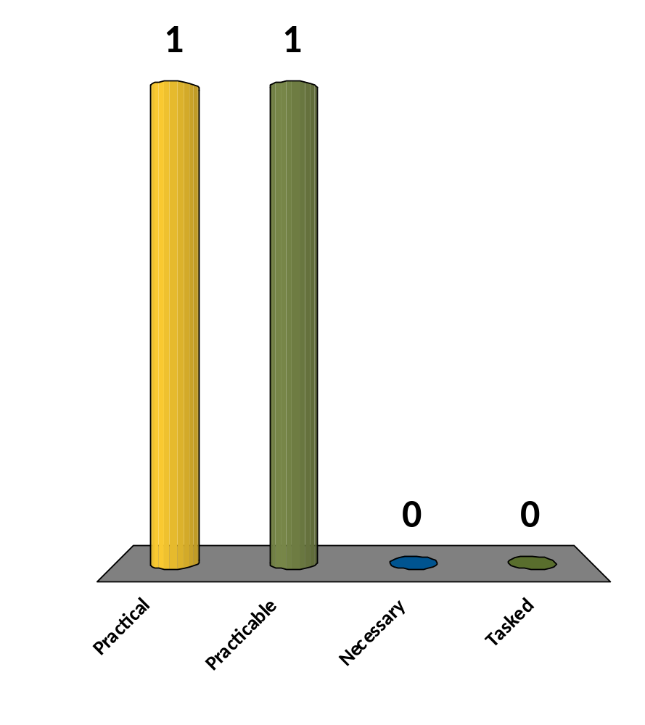
“Each chaplain shall, when __________, hold appropriate religious services at least once on each Sunday [or applicable holy day] for the command to which he is assigned . . .” Title 10, 3547, US Code
Practical
Practicable
Necessary
Tasked

Slide 12

Team Racing Scores
COL
90
LTC
5

Slide 13
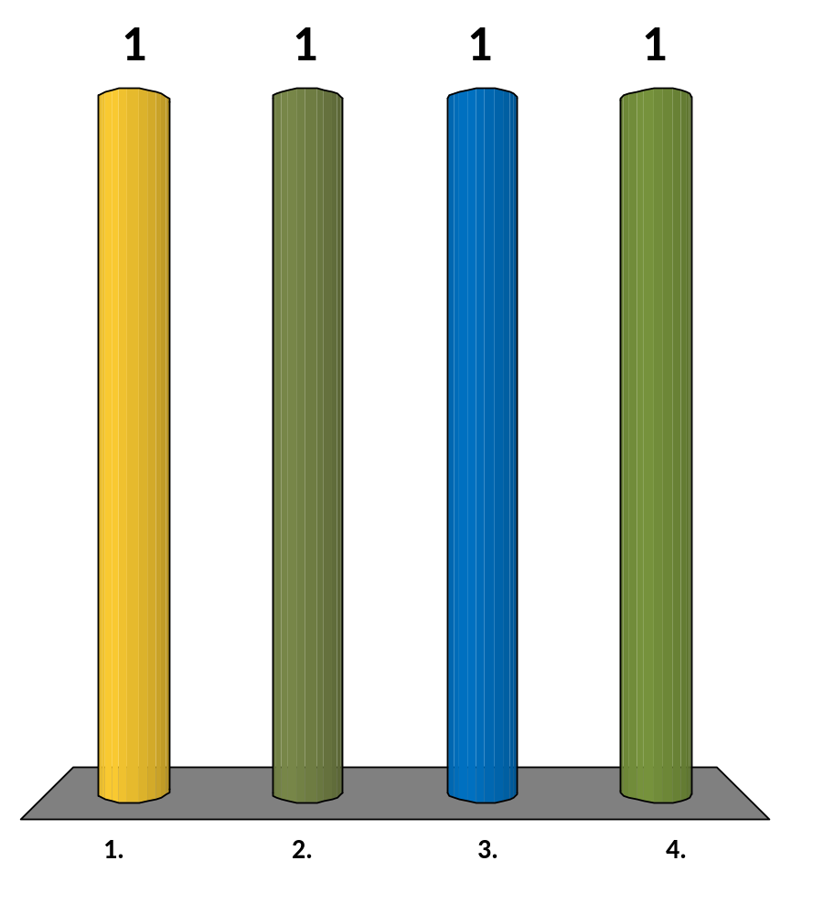
What describes the frequency of your preaching?
I preach once a month or more.
I preach 6-10 times a year.
I preach less than 6 times a year.
I preach only when tasked.

Slide 14
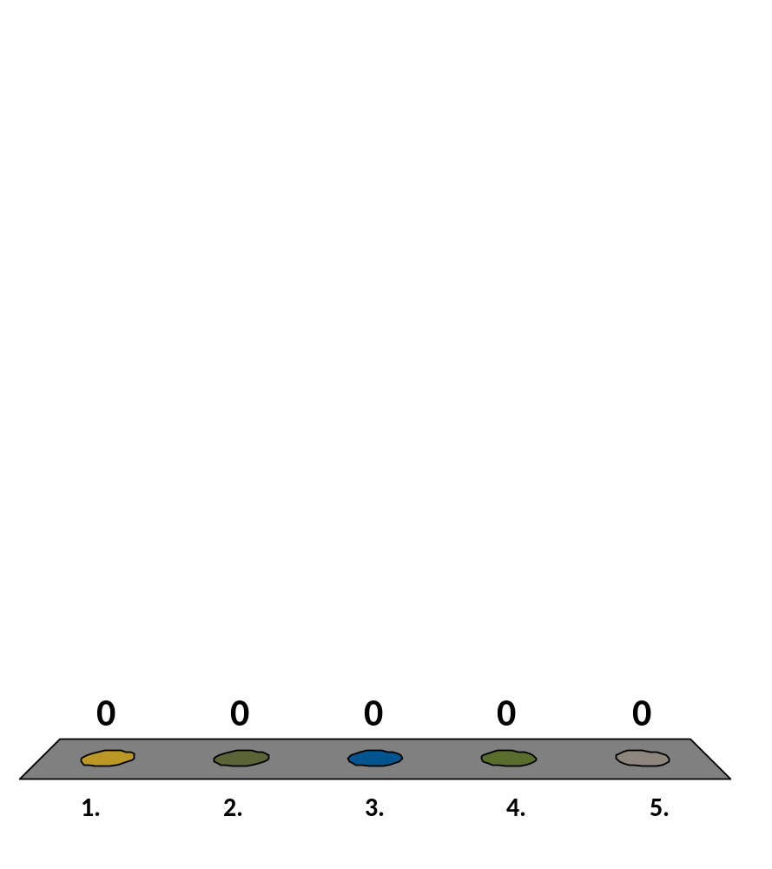
I have been given feedback on my sermons.
Always
Often
Sometimes
Seldom
Never

Slide 15
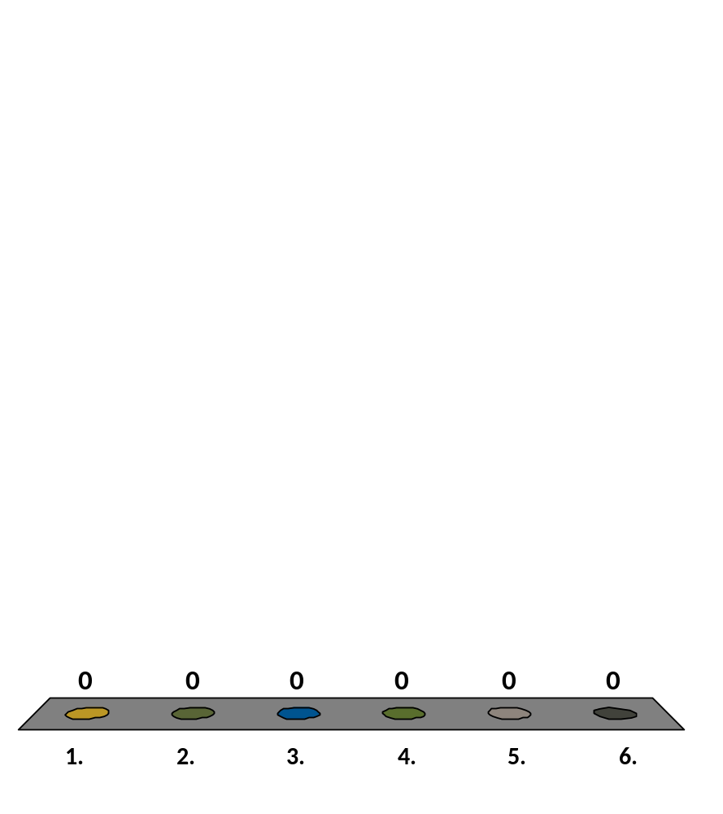
I have been given feedback by. . .
(List all that apply)
Chapel Team
Superior
Subordinate
Family Member
Congregation
No One

Slide 16

I have given feedback to. . .
(List all that apply)
Chapel Team
Superior
Subordinate
No one

Slide 17

When I have given feedback I have used. . .
(List all that apply)
A Standardized Form
Personal Comments
Group Discussion
I Don’t Give Feedback

Slide 18
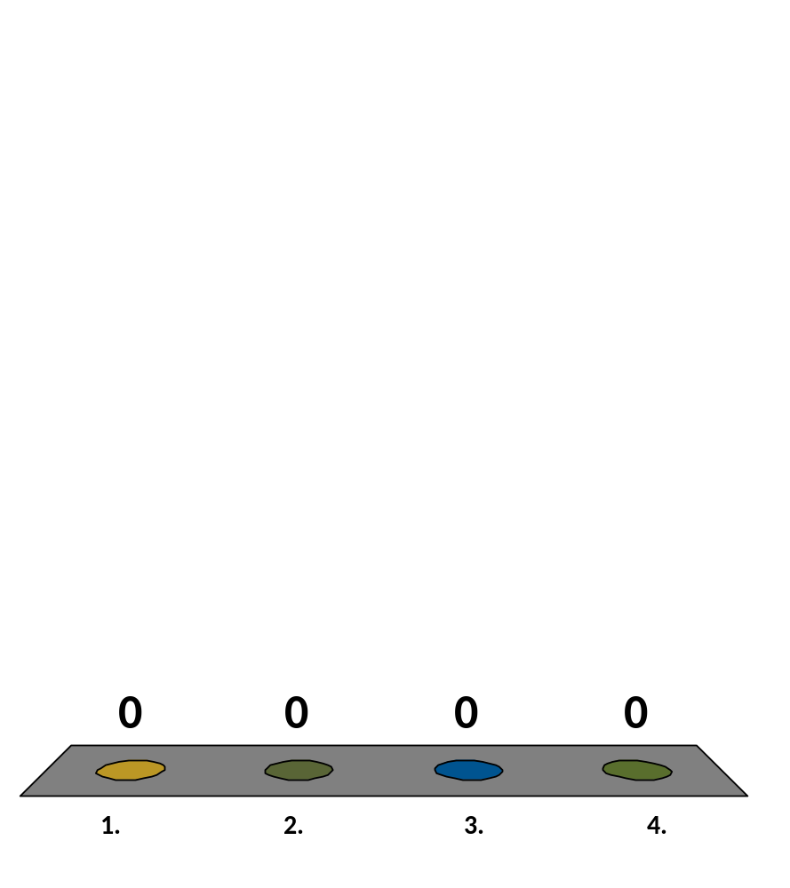
Preaching Competency has value in the Army Chapel?
Strongly Agree
Agree
Disagree
Strongly Disagree

Slide 19

I have used the following tools within the last year to improve My Preaching:
(List All that Apply)
Read a book on preaching
Listened to sermons
Received feedback
Self assessment
Used web resources
Other

Slide 20
Terminal Learning Objective (TLO)
ACTION: Apply supervisory skills IOT evaluate sacred communication.
CONDITIONS: Given classroom instruction and practical exercises in field and classroom settings.
STANDARD: Use of Communication Coaching Form (CCF) and Communication Coaching Self Evaluation Learning Form (CC-SELF) within the Worship setting to demonstrate peer and self evaluation.

Slide 21
Administrative Data
Safety Requirements: NONE
Risk Assessment: LOW
Environmental Considerations: NONE
Evaluation: Use of Communication Coaching Form (CCF) and Communication Coaching Self Evaluation Learning Form (CC-SELF) within the Worship setting to demonstrate peer and self evaluation.

Slide 22
OverView
Develop the Chaplain’s Skill in supervision to coach and mentor others for greater effectiveness in Sacred Communication.
Use of the Preacher Assessment Cycle (PAC)
& The Communication Coaching Form (CCF)
1) Person of the Preacher
2) Preparation of the Message
3) Presentation of Message

Slide 23
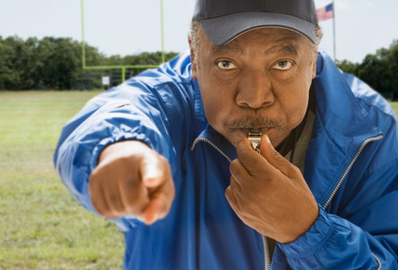
What makes a Good Coach?
Characteristics of a Coach
Connections between Coaching and Preaching

Slide 24
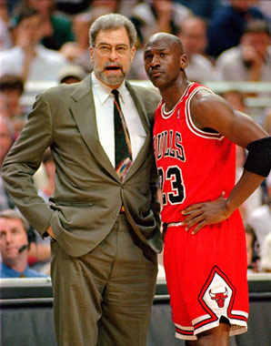
Coach and Player
Different Roles - Same Team

Slide 25
Bottom Line: Coaching Matters
Intentional Communication Coaching will Transform:
1) You
2) Those you lead
3) Congregations served

Slide 26
Communication Coaching Truths
We evaluate, assess, and work on the things that are important to us.
Preaching is an Art and Science. It is a Calling and a Skill.
Manage the tension.
3) Coaching is not about duplication.

Slide 27
Communication Coaching Truths (Cont.)
4) The goal of coaching is assessment, observation, and honest feedback.
5) Communication Coaching looks at content (what is said) and Delivery (How it is said).
6) The goal of good coaching is to improve future performance.

Slide 28
Preacher Assessment Cycle (PAC)
Person – Soul - Formation
*Self
All of Life
Education
Personality
Context
Preparation – Skill - Information
*Study
Planning
Time
Process
Presentation – Sermon – Evaluation
*Sermon
What was said?
Point & Purpose
How it was said & heard?
Feed Back
Coaching
1) Preacher (self-assessment)
2) Listener Assessment
*Verbal and Non-Verbal
*Content, Clarity, Conviction

Slide 29
Preacher Assessment Cycle (PAC)
Person -What’s going on with me?
*Life Situations
*Spiritual Formation
*Self-Care
Preparation - What am I going to say?
*Textual Study
*Manuscript/Outline
Presentation – What was said?
*From Written to Oral
*Delivery (What/How message was heard.)
*Coaching Feedback Loop

Slide 30
PAC & Coaching Feedback Loop
Prep.
Pres.
Person

Slide 31
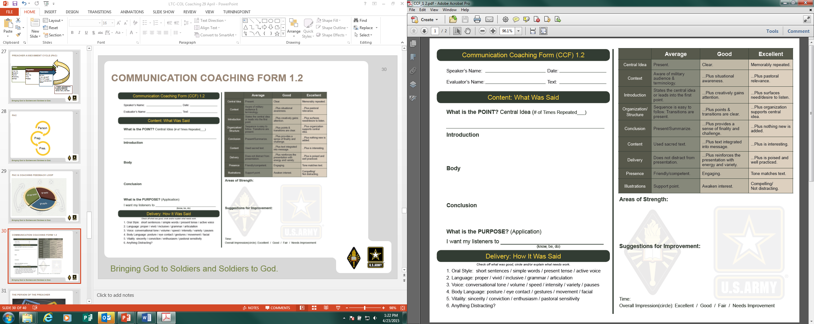
Communication Coaching Form 1.2

Slide 32

The Person of The Preacher

Slide 33

The Cultivation of the Person will
the Message!

Slide 34


Slide 35
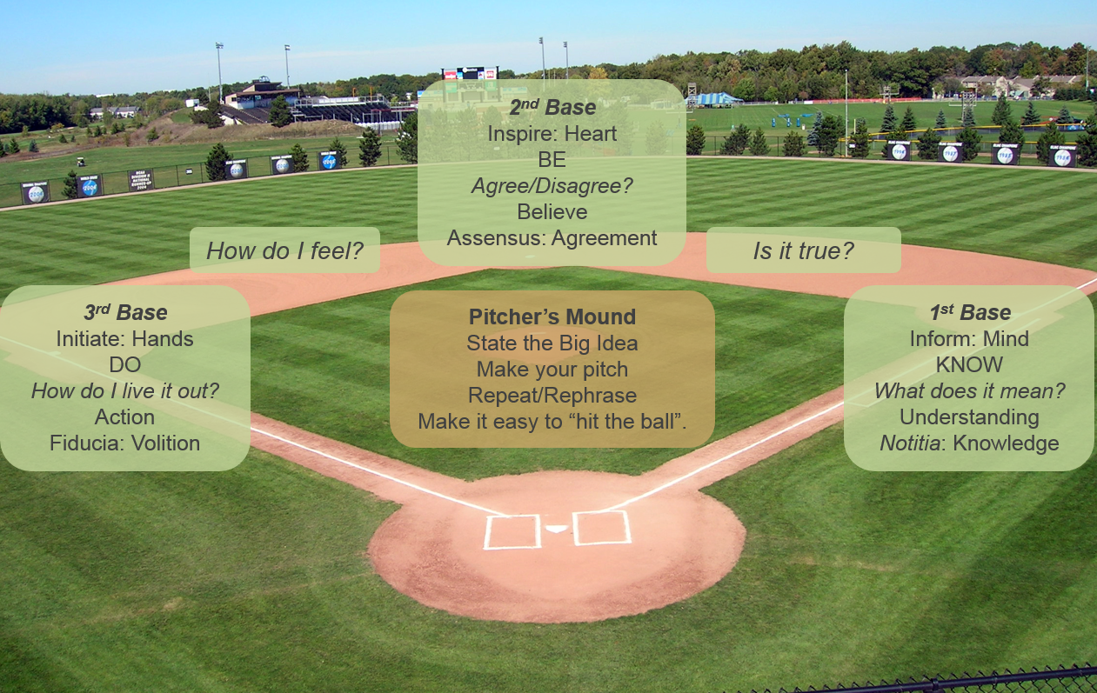
Running the Bases

Slide 36

Tools for Clarity

Slide 37
Coaching Tips & Ideas
Take time. Be intentional. Give specific feedback.
Ask yourself and them “How can I help?”
Develop a Plan
*Read
*Share Resources
*Teach/Coach
*Evaluate
*Encourage
What else? Be creative

Slide 38







Advanced Sacred ComMS Resources

Slide 39
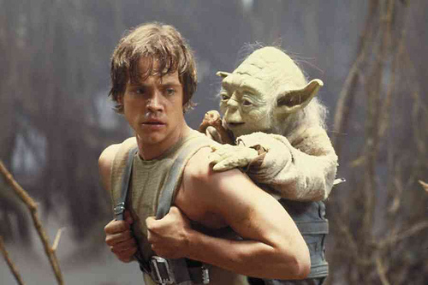
Mentor not hero
Remind Luke of the importance of his role

Slide 40
Communication Coaching challenge
As you shift into a coaching role, it will open up greater opportunities.
You are in your position of influence “for such a time as this.”
Engage and provide useful feedback.
You can inspire and encourage the next generation of Chaplain leaders in pulpits across the Corps!

Slide 41
SUMMARY
What we covered today:
Develop the Chaplain’s skill in supervision to coach and mentor others for greater effectiveness in Sacred Communication.
Engage, Have a plan, Affirm strengths
Address strategies to strengthen the message
What are you waiting for?

