Slide 1
Evaluate Sacred COmms
*Communication Coaching
CH (MAJ) Brandon Moore
*Homiletics SME, USACHCS
Notes:
Notes for lesson 4: SC 4: Evaluate Sacred Comms
Task 85D-201-8014 Perform Supervision of Sacred Communication (Update to Evaluate Sacred Comms) C: Lv 5
Slide 1
Attention: Have you ever had someone Evaluate your message?
What kind of feedback have you received? How often? Was it helpful?
Motitator: Have you used the CCF and what has it been like? Helpful? Overwhelming? Confusing? (Handout CCF)
Instructor note: Even if students have already seen Communication Coaching Form hand them out one and discuss reason for form.
Common objections are to much information, confusing, and unsure how to use. Reinforce to students the importance of having an objective tool and it is ok to use all or part of form to provide specific developmental feedback.
Do you think it is important to Evaluate Sacred Communications as a Chaplain.
Why or why not?
Instructor note: Help students to understand the importance is in the development of the communicator.

Slide 2
Terminal Learning Objective (TLO)
Action: Evaluate Sacred Communication
Condition: Given reference material, resources, time for discussion, and a PE.
Standard: Evaluation includes
Contrast development models
Compare Coaching to establish best practices
Apply 6 Steps of Sacred Comms Checklist
Create Coaching Philosophy
Assess developmental tools
Choose book for self and peer development
Coaching PE after Lunch
Notes:
Slide 2
Highlight TLO and various LSAs
LSA 1: Contrast development Models
LSA2: Compare Coaching to establish best practices
LSA 3: Apply 6 Steps of SC Checklist
LSA 4: Create Developmental model using framework given
LSA 5: Assess developmental tools
LSA 6: Choose book for self and peer development
PE will be after lunch, each student will present and Coach to model the principles learned in class.

Slide 3
A Model for Developing Sacred Communication
Leadership Lens
ADRP 6-22
Development Model
Skill Level
Supervision
Coaching
Basic
Sacred Comms Skills
Theological Integration
Model for Funeral Messages
The Identity of the Sacred Communicator
Achieves
Develops
Supervisory Chaplains
COMPETENCIES
Leads
Intellect
ATTRIBUTES
All Chaplains
Character
Presence
Notes:
Slide 3
Army doctrine begins with the profession and the leader. The foundation of leadership is the character and presence of the individual. In older leadership manuals, this was expressed as BE-KNOW-DO. Today, Leadership Attributes and Competencies work together on the inside to aid the individual in influencing others toward organization goals and mission accomplishment.
This lesson will focus on Supervision and Coaching. This is what we are trying to achieve in all the Sacred Comms lessons.
They all build on this final lesson, the focus is development.

Slide 4
Contrast Development Models
Counseling:
Coaching:
Mentoring:
Army Resources: ADRP 6-22 Army Leadership, Ch 7 (10-12)
FM 6-22, CH 3
AR 623-3 Evaluation Reporting System Appendix C-7 b
Notes:
Slide 4
LSA 1: Contrast development Models (using Army Doctrine ADRP 6-22)
The Army has 3 leadership development models Counseling, Coaching, Mentoring.
How would you define each and what are the differences?
Highlight Army Resources:
ADRP 6-22 Army Leadership, Ch 7 (10-12) Key to understanding Development from the Army’s perspective
FM 6-22, CH 3 Details specific approach and questions to use.
AR 623-3 Evaluation Reporting System Appendix C-7 b
Highlight the section regarding “the list below represents some of those areas in which the chaplain may be rated to be the most competent and have the greatest potential (1-14)
Ask: What do you thing is listed first?
Preaching and leading in worship.
State: I don’t think that this list is in order of most important, but most obvious.
So why don’t we rate, evaluate, or even observe others preaching? (Pause)
We can do better. We must put emphasis on and evaluate what is most important.
Think about it? As an Army Chaplain, what is more important: Push ups or Preaching?
Explain: If you fail the Push ups on a PT test? You will get evaluated, helped, coached and retested. If you still can’t achieve the min push ups you will be kicked out of the Army.
But what about preaching? (pause) Do we care as much about preaching as we do push ups?
If you or other chaplains are struggling to preach, have a clear thought, or unable to present a compelling message from a Sacred Text?
What happens to them?
At worst they are marginalized, talked about but then generally let of the hook for preaching and then promoted.
**Coaching and evaluation is the key for development in Push ups and I believe it can be the same in preaching.

Slide 5
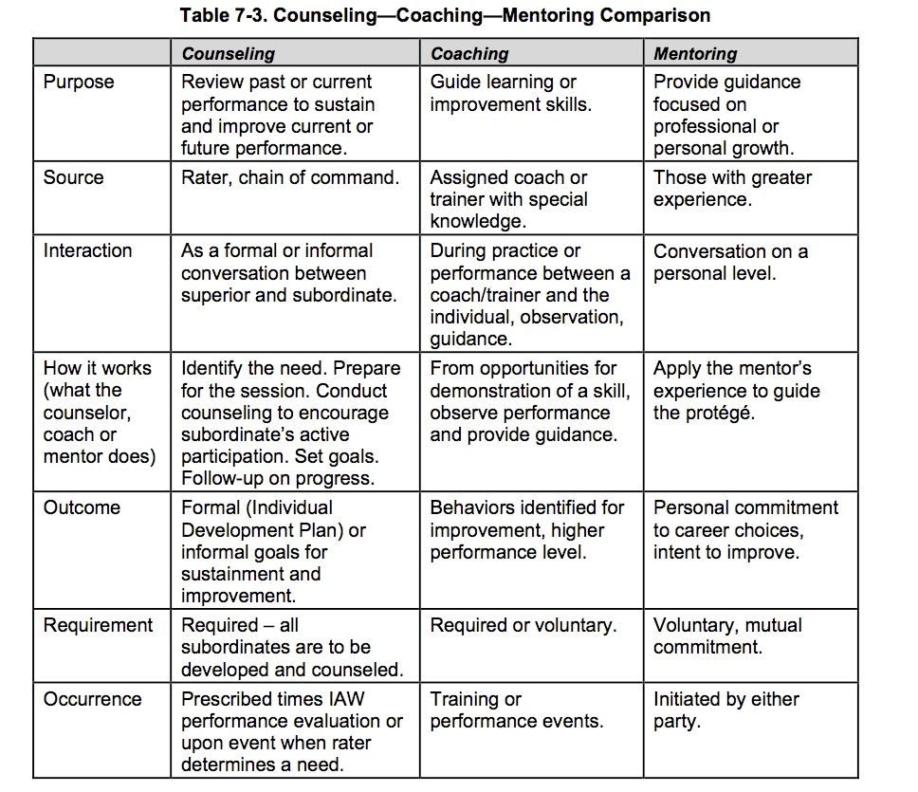
Notes:
Slide 5
Table from ADRP 6-22 show comparison of Development models
Allow students to look at it and highlight a few differences.

Slide 6
Person
Coaching
BE
Counseling
Mentoring
KNOW
DO
Performance
Notes:
Slide 6
This venn diagram is to show the overlap and interconnectedness of developmental models.
The highlighted area is to show the sweet spot of coaching and how it is complex but powerful to teach skill and develop others.

Slide 7
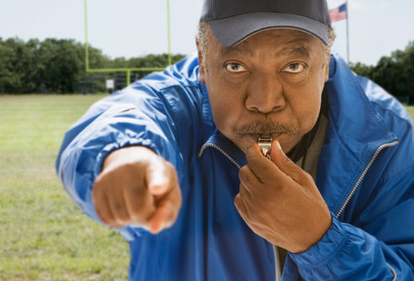
What makes a Good Coach?
Characteristics of a Coach
Discuss Experiences with Coaching
Connections between Coaching and Communication
Notes:
Slide 7 LSA2: Compare Coaching to establish best practices
Ask students to list Characteristics of a good Coach?
Go around room asking for them to list various and if time allows add a story or antidote to demonstrate
Optional: write on a white board to compile list.
examples include: Knows the game, cares about players, empathy, upholds standards, Honest, Inspiring etc.

Slide 8
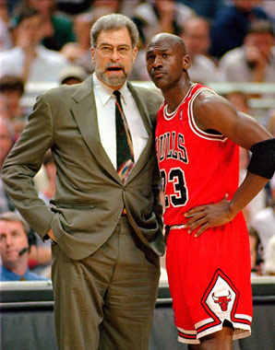
Coach and Player
Different Roles - Same Team
Notes:
Slide 8 Discuss different roles and goals. Player and coach
Coach sees the larger field from a different perspective. Wants to bring the best out of each player for a common goal (WIN).
In coaching, ask yourself, “What’s the win?” Short term you can use Acrostic “What’s Important Now (WIN)” or develop toward long term goal (win, Gold metal, etc.).
Ill) discuss role of coach verses judge (for example Olympics).
When a player messes up, the coach has a relationship, where as the judge offers a score or highlights mistakes.
The Role of the Coach is to Evaluate, in order to develop and encourage, win or lose.
The Role of the Judge is to Evaluate in order to critique and determine a winner.
If time allows Discuss examples

Slide 9

Sacred Communication coaching Checklist: 6 Steps
Step 1: Identify Type & Purpose of Presentation
Sermon
Funeral
Speech
Class
Brief
Other
Notes:
Slide 9 (Refer to handout, explain and answer questions)
LSA 3: Apply 6 Steps of SC Checklist
Hand out check list to class and walk through it and discuss Slides 7-12
Step 1. Identify the type and purpose of the presentation.
Sermon: Religious discourse discussing a sacred text in the context of a religious worship service.
Funeral (Memorial Ceremony, Funeral Service, Grave side Service): Remarks made to remember and honor a Soldier or Family member focusing on the decedent's faith and service, while providing comfort to those in attendance.
Speech: Oral presentation given in a broader context such as a graduation, a formal dinner address, a patriotic or community event.
Class: Teaching with discussion in a classroom setting.
Brief: Presentation for command within the context of a meeting.
Other: Prayer, Lesson, Counseling, Dialogue etc.

Slide 10
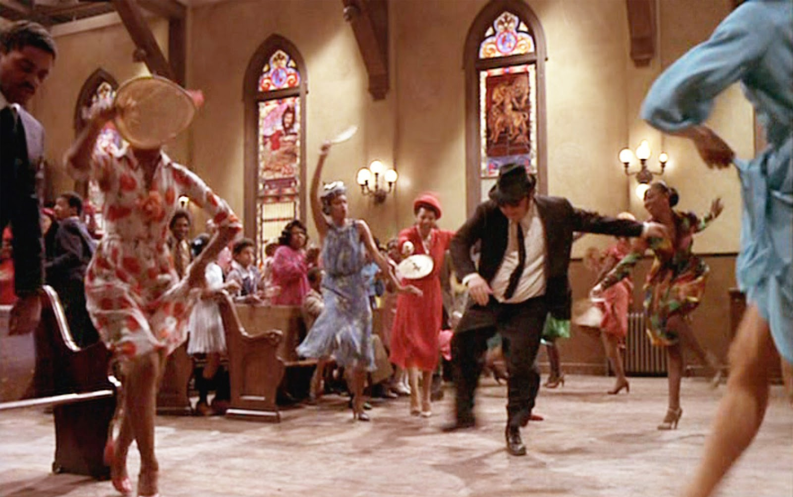
Step 2: Context
Who? Where? How Long? Distractors? Purpose?
Notes:
Slide 10 (Refer to handout, explain and answer questions)
Step 2: Context
2. Determine how the context affects the presentation.
Describe the audience and state if attendance is mandatory.
Assess possible expectations of the audience.
Identify location and note any environmental details that would affect the presentation.
Determine the allotted time for both the overall event and the specific presentation.

Slide 11
Step 3: Speaker Assessment Cycle (SAC)
Person – Soul - Formation
In what ways did the speaker add to or distract from the message?
Preparation – Skill - Information
Did the message reveal preparation & clear concise thought?
Presentation – Sermon - Evaluation
Was the message contextually relevant, within time constraints, & did it accomplish its purpose?
Feed Back
Coaching
1) Presenter (CC-SELF)
2) Supervisor (CCF)
*Verbal & Non-Verbal
*What was the overall impact?
Notes:
Slide 11 (Refer to handout, explain and answer questions)
Step 3: Understand and Analyze the Speaker Assessment Cycle (SAC)
3. Analyze the three components of the Speaker Assessment Cycle (SAC). (Fig. 1)
Person: In what ways did the speaker add to or distract from the message? (Examples: dynamic, engaging, focused, distracted, angry, confused, etc.)
Preparation: Did the message reveal preparation and clear concise thought? (Examples: logical thought, critical thinking, depth of reason, smooth transitions, etc.)
Presentation: Was the message contextually relevant, within time constraints, and did it accomplish its purpose? (Examples: used appropriate illustrations and terms, understood and adapted to the audience and complied with the time constraints, etc.)

Slide 12
Speaker Assessment Cycle (SAC)
Person -What’s going on with me?
*Life Situations
*Spiritual Formation
*Self-Care
Preparation - What am I going to say?
*Textual Study
*Manuscript/Outline
Presentation – What was said?
*From Written to Oral
*Delivery (What/How message was heard.)
*Coaching Feedback Loop
Notes:
Slide 12
Step 3 Continued

Slide 13
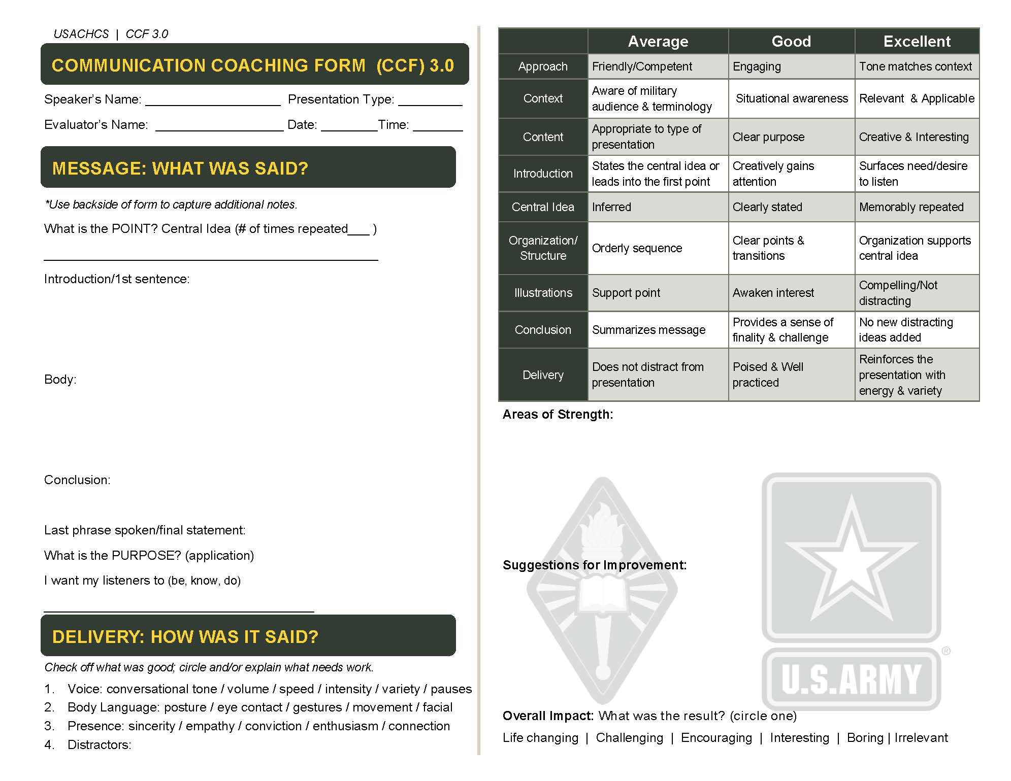
Step 4: Use Rubric
Notes:
Slide 13 (Refer to handout, explain and answer questions)
Step 4
4. Assess the presentation using an appropriate rubric.
Communication Coaching Form (CCF). (Fig. 2-3)
SOAR feedback: Situation, Observation, Associate & Assess, Reinforce & Recommend (FM 6-22, paragraph 3-31 & figure 3-3) (Fig. 4)
Communication Self Evaluation Learning Form (CC-SELF) Presenter's self-evaluation form to be filled out before coaching session with the supervisor. (Fig. 5)
Others: If desired, a different rubric could be developed from ATP 1-05.02 for funerals and memorials. FM 6-0, figure 7-4 could be used for speeches and briefings. These rubrics need to include clear objectives and specific areas of assessment.

Slide 14
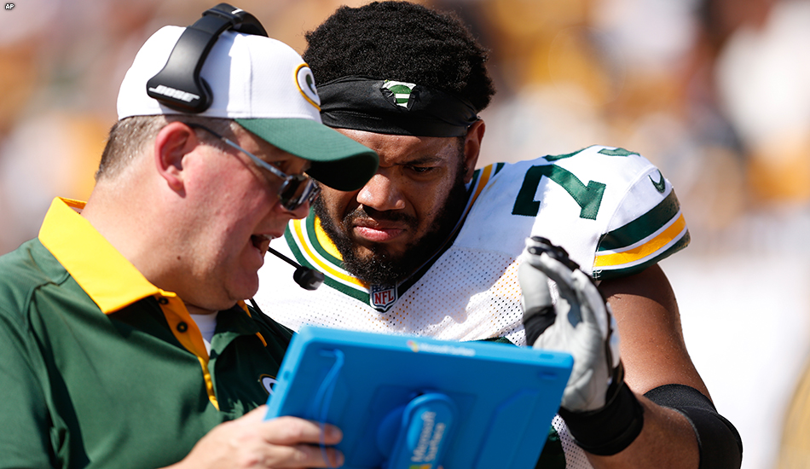
Step 5: pre-session
Step 6: Coaching Session
Notes:
Slide 14 (Refer to handout, explain and answer questions)
Step 5 and 6
5. Compare supervisor's and presenter's assessments & identify differences.
Have the presenter watch the video of the presentation, if available, to foster self-awareness and clear understanding of exactly what happened from the perspective of the audience.
Direct the presenter to use the Communication Coaching Self-Evaluation Learning Form (CC-SELF) or another written form that models the selected rubric (see performance step 4).
If time does not allow or a written self-assessment is impractical, discuss with the presenter his/her personal assessment of the presentation.
6. Discuss observations, providing specific feedback, & create a development plan to improve skills.
Discuss presenter's self-assessment by asking future-oriented questions such as: "If you were to present again, what would you do the same & what would you do differently?"
Provide a written assessment. (CCF or other notes)
Debrief observations: Be specific, affirm strengths, and provide suggestions for improvement.
Develop a plan for improved skill in communication addressing observed areas of strength and improvement. Highlight developmental area from SAC to focus future growth.
Discuss overall impact.

Slide 15

Create A Coaching Philosophy
I + C²
T
Notes:
Slide 15
LSA 4 Develop Coaching principles and Philosophy Slides 13-15
LSA 4: Create Developmental model using framework given
As we begin to understand coaching we must create a framework or philosophy regarding what we believe about it. As discussed earlier we have seen and heard both good and bad coaching and coaching needs to have a developmental bias. However, what equation would you use?
Development will not just happen. The second law of thermodynamics states that an isolated system's entropy never decreases.
A system has a bias toward disorder. So as coaches we must have a bias toward development.
So this is the Developmental Bias equation
Try this one out: I + C2 over T
Intentionality + (Coaching x Care)
Time
= produces the Audacious Development of Leaders
If time allows can make reference to coaching resources and tools:
Peter Jensen, The Winning Factor
http://www.performancecoaching.ca
Michael Bungay Stanier, The Coaching Habit
Gillian Jones & Ro Gorwell , 50 Top Tools for coaching: A complete toolkit for developing and empowering people.

Slide 16

5 Communication Coaching Principles
Notes:
Slide 16 5 Communication Coaching Principles
How would you define what you believe about Coaching and development. You can build a philosophy and understand the equation
But to combat the 2nd law of thermodynamics and summoning the audacity to create order from Chaos, requires deeper thinking and clarity.
Let’s look at 5 Communication Coaching principles for your consideration.
Slide 17- 21 walks through the 5 principles.
1. We evaluate, assess, & work on the things that are important to us.
2. Sacred Communication is an art and science
3. Coaching is not about duplication, but development
4. Communication Coaching looks at CONTENT & DELIVERY
5. The goal of good coaching is to Improve Future Performance (IFP).

Slide 17
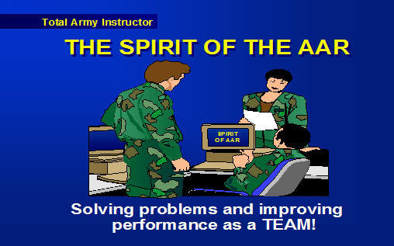
#1 We evaluate, assess, & work on the things that are important to us.
Notes:
Slide 17 Principle #1: We evaluate, assess, & work on the things that are important to us.
Explain and discuss: The Army is all about AAR’s even Think about this vintage slide.
There is a reason we don’t use slides like this and cheesy clip art.

Slide 18



#2 Sacred Communication is an
Notes:
Slide 18: Principle 2: Sacred Communication is an Art and Science.
Explain and discuss:
IT is an “Art” and “Science”
It is a Calling and a Skill.
Manage the tension.

Slide 19
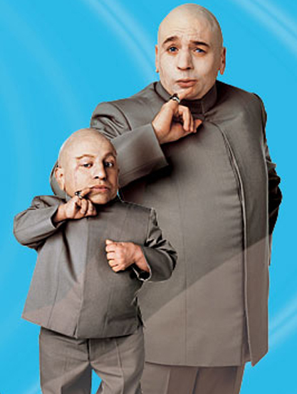
#3 Coaching is not about duplication.
Notes:
Slide 19: Principle 3: Coaching is not about duplication, but Development.
Explain and discuss:
Coaching is not about creating a mini me that is inferior to you. It is to develop another, who is different but helping them get even better.
- A key element of coaching is development: through observation, assessment, challenge, support and specific feedback.

Slide 20

#4 Communication Coaching looks at CONTENT & DELIVERY
Notes:
Slide 20 Principle #4: Communication Coaching looks at CONTENT & DELIVERY
Explain and discuss: Communication Coaching looks at CONTENT (what was said)
and DELIVERY (How it was said). Refer to CCF.

Slide 21

#5 The goal of good coaching is to Improve Future Performance (IFP).
Notes:
Slide 21 Principle #5: The goal of good coaching is to Improve Future Performance (IFP).
Explain and discuss: What does IFP look like specifically?
(Have students brain storm examples.)
Ask presenter and give developmental tips.
Begin working on an Individual Development Plan (IDP).

Slide 22

Coaching Tools
Notes:
Slide 22
LSA 5: Assess Developmental tools
What are various tools that you would use to help others in Communication Coaching? (have students brain storm, list various tools)
Books/Articles
Videos
Audio
Podcasts
Evaluation Forms
Websites:
www.preachingtoday.com
www.preaching.org
www.workingpreacher.org
Building team
Sermon Planning/ Sermon Series

Slide 23
Choose book for self & peer development
Write a 2 to 3 page double-spaced analysis paper based on what you have read in (1) of the following books:
Items to include:
Your Name
Book Title and brief description in intro paragraph.
Explain (4) topics or principles discussed in book
Identify (1) significant idea you learned or was reinforced
Explain (1) principle you will integrate to improve your preaching
List two (2) specific tools, ideas, or principles, you will use to help others in preaching.
*NOTE* DO NOT write about why you dislike the book. If you dislike the book see instructor and trade it for another book.
Due: 1 Month from date assigned unless later date is given in ISAP.
Notes:
Slide 23
LSA 6: Choose book for self and peer development
Instructor Note:
Have various preaching books out and explain about each one and instruct each student to choose one to read and wrtite a 2-3 page analysis paper.
Write a 2 to 3 page double-spaced analysis paper based on what you have read in (1) of the following books:
Items to include:
Your Name
Book Title and brief description in intro paragraph.
Explain (4) topics or principles discussed in book
Identify (1) significant idea you learned or was reinforced
Explain (1) principle you will integrate to improve your preaching
List two (2) specific tools, ideas, or principles, you will use to help others in preaching.
*NOTE* DO NOT write about why you dislike the book. If you dislike the book see instructor and trade it for another book.
Due: 1 Month from date assigned unless later date is given in ISAP.
Books to Choose from
Alkhairo, Wael, Speaking For Change
Anderson, Chris, TED TALKS
Arthurs, Jeffrey, Preaching With Variety
Duarte, Nancy, HBR Guide to Persuasive Presentations
Edwards, J. Kent, Deep Preaching
Keller, Timothy, Preaching
Lischer, The Company of Preachers
Robinson, Haddon, Biblical Preaching
Robinson, Haddon & Larson,Brian, The Art & Craft of Biblical Preaching
Stanley, Andy & Jones, Lane, Communicating for a Change
Port, Michael, Steal the Show
Wiersbe & Wiersbe, The Elements of Preaching.

Slide 24
Practical Exercise
Presenter
Coach
5 Min to present sermon based on assigned text
Key: Clear Idea and purpose
*3-5 min for coaching
1) Affirm Presenter
2) Solicit brief group feedback
3) Give Specific observations & tips
-Area of strengths
-Suggestions for improvement
*Instructor will offer tips and help coach as needed.
Notes:
Slide 24
PE: Each Student was given a text and told to be ready to preach a 5 min sermon during last class (SC3 Analyze The elements of Sacred Communication).
Students will be given the communication coaching Short Form (CCSF) to be used with this exercise.
Instructor note: Have the number of students listed on the board 1-15 and have them sign up with their name and scripture passage.
Class the students in order and have a clock to time the 5 min. Once the timer has beeped the presenter must stop.
After the designated coach will begin coaching with the help of presenter, class, and instructor.
The goal is within 3-5 min apply coaching principles by: 1) Affirming Presenter 2) Soliciting brief group feedback and 3) Giving Specific observations & tips. Begin with specific areas of strength, then provide suggestions for improvement. And end on a specific development area.
*Instructor will offer tips and help coach as needed.

Slide 25

COACH not hero
Remind Luke of the importance of his role
Notes:
Slide 25: COACH Not Hero
Remind Luke of the importance of his/her role.
As you shift into a coaching role, it will open up greater opportunities.
You are in your position of influence “for such a time as this.”
Engage and provide useful feedback.
You can inspire and encourage the next generation of Chaplain leaders in pulpits across the Corps!

Slide 26
Coaching Tips & Ideas
Take time. Be intentional. Give specific feedback.
Ask yourself and them “How can I help?”
Develop a Plan
*Read
*Share Resources
*Teach/Coach
*Evaluate
*Encourage
What else? Be creative
Notes:
Slide 26: Coaching Tips and Ideas
Today we discussed communication coaching and creating a plan and philosophy for developing others.
Take time. Be intentional. Give specific feedback.
Ask yourself and them “How can I help?”
What Questions do you have?

Slide 27
SUMMARY
*Evaluate Sacred Communications
What we covered today:
Contrasted development models
Compared Coaching to establish best practices
Applied 6 Steps of Sacred Comms Checklist
Created Coaching Philosophy
Assessed developmental tools
Chose a book for self and peer development
And had Coaching PE after Lunch
Notes:
Slide 27 Summary
Evaluate Sacred Communications
What we covered today:
Contrasted development models
Compared Coaching to establish best practices
Applied 6 Steps of Sacred Comms Checklist
Created Coaching Philosophy
Assessed developmental tools
Chose a book for self and peer development
And had Coaching PE after Lunch

