Slide 1
*Analyze the Elements of Sacred Communication
CH (MAJ) Brandon Moore
*Homiletics SME, USACHCS

Slide 2

TED
TED is devoted to ideas worth spreading. While we curate ideas we think are worthy of that estimation, we also acknowledge not everyone feels the same – and certainly not all the time. Some ideas may offer just one perspective on a complex issue, while others invite thoughtful criticism and debate.
Here are some of the asterisks we place after the phrase ideas worth spreading...
In short-talk form. Also music, dancing, art. And yo-yos.
A new one every day. Handpicked.
They're not all perfect. But they are all short.
And maybe even, ahem, acting on.
Free. Forever. Thank you, Internet.
Plus a few ideas worth shredding. Or so we're told. You decide.
Like a virus. But with inspiration instead of sneezing.
Probably. But you be the judge.
And debating. And criticizing. And improving.
Or at least worth arguing about.
Skeptics welcome.
Well, the spreading part is up to you.
Knowledge in dangerously addictive short doses Or challenging.

Slide 3
Terminal Learning Objective (TLO)
ACTION: Analyze the elements of Sacred Comms
CONDITIONS: Given classroom instruction in a classroom settings.
STANDARD: Analysis includes:
Analyze elements viewed from TED talks
Compare Definitions of Preaching
Categorize elements of the Sermon
Examine Texts to identify Central idea
Create 5 min sermon based on assigned text with a clear point and purpose
Notes:
Slide #4-5 TLO slide four and five are the TLO slides
Discuss action conditions and standards, what’s expected

Slide 4
Administrative Data
Safety Requirements: NONE
Risk Assessment: LOW
Environmental Considerations: NONE
Evaluation: NONE

Slide 5
A Model for Developing Sacred Communication
Leadership Lens
ADRP 6-22
Development Model
Skill Level
Supervision
Coaching
Basic
Sacred Comms Skills
Theological Integration
Model for Funeral Messages
The Identity of the Sacred Communicator
Achieves
Develops
Supervisory Chaplains
COMPETENCIES
Leads
Intellect
ATTRIBUTES
All Chaplains
Character
Presence
Notes:
Army doctrine begins with the profession and the leader. At the heart of leadership is the character and presence of the individual. In older leadership manuals, this was expressed as BE-KNOW-DO. Today, Leadership Attributes and Competencies work together on the inside to aid the individual in influencing others toward organization goals and mission accomplishment. Effective ministry begins with the person and identity. KNOWING what to DO is only as effective as the presence and character ( who they are (BE)).

Slide 6
Speaker Assessment Cycle (SAC)
Person – Soul - Formation
In what ways did the speaker add to or distract from the message?
Preparation – Skill - Information
Did the message reveal preparation & clear concise thought?
Presentation – Sermon - Evaluation
Was the message contextually relevant, within time constraints, & did it accomplish its purpose?
Feed Back
Coaching
1) Presenter (CC-SELF)
2) Supervisor (CCF)
*Verbal & Non-Verbal
*What was the overall impact?

Slide 7
Speaker Assessment Cycle (SAC)
Person -What’s going on with me?
*Life Situations
*Spiritual Formation
*Self-Care
Preparation - What am I going to say?
*Textual Study
*Manuscript/Outline
Presentation – What was said?
*From Written to Oral
*Delivery (What/How message was heard.)
*Coaching Feedback Loop

Slide 8
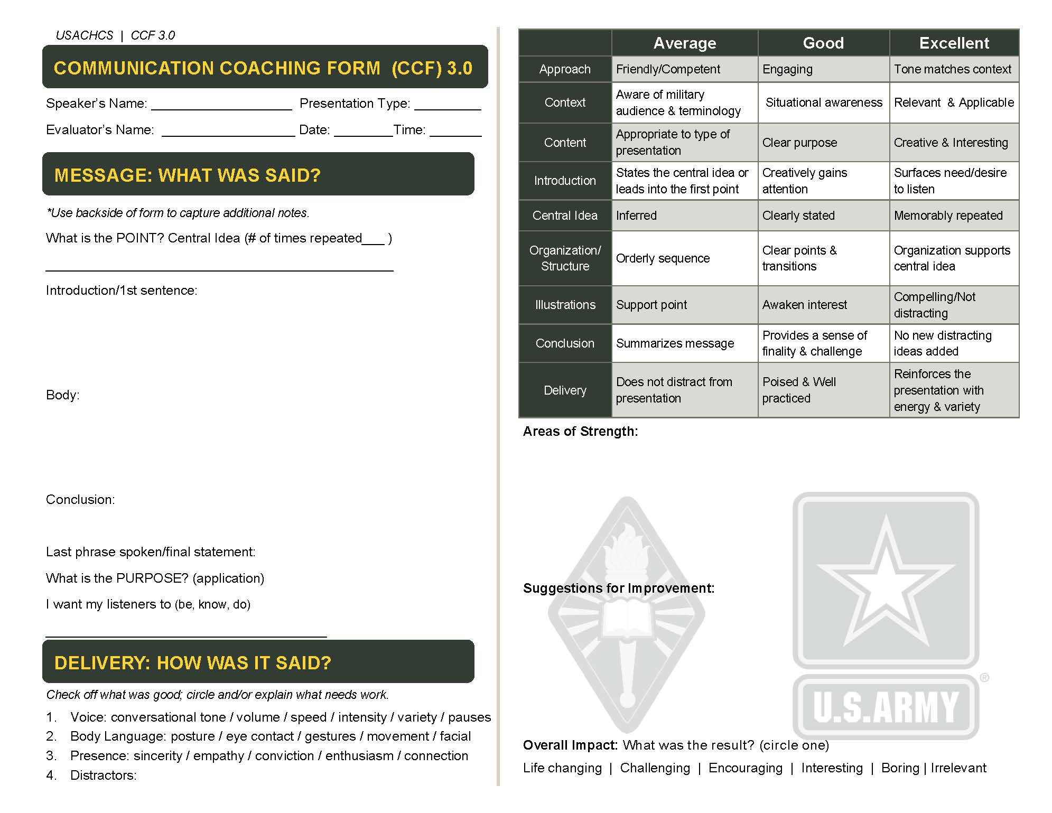

Slide 9
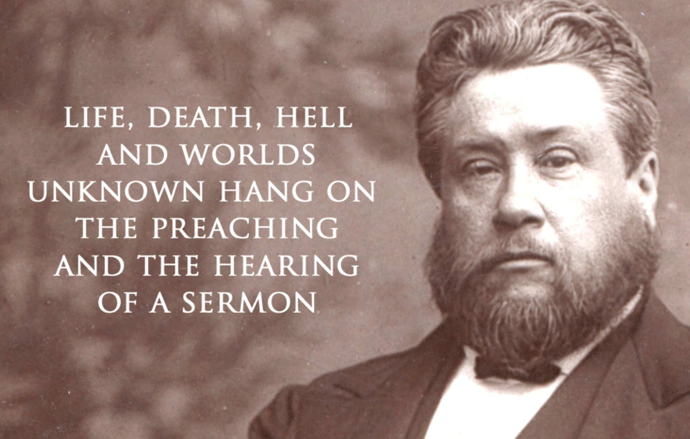
C.H Spurgeon on Preaching
Notes:
Slide #10 Spurgeon quote
Have students read and give feedback on what they think about the quote. Highlight the importance of preaching and the fact that there are two dimensions that are important both preaching and hearing.

Slide 10
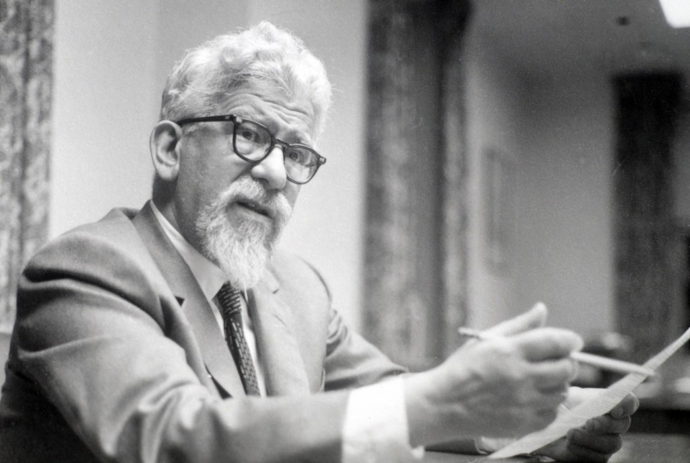
Abraham Joshua Heschel on Preaching
      “Preach in order to pray.
      Preach in order to
      inspire others to pray.
      The test of a true sermon is
      that it can be converted
      to prayer.”
      Moral Grandeur and Spiritual Audacity, 117).
Notes:
Slide #3 Heschel quote
Have students read and respond to thoughts on the quote. Focus on the idea of preaching as prayer and ask what does that mean?

Slide 11
Thoughts on Preaching
What is Preaching?
What are the elements of the sermon?
As you think about the sermons you have heard or preached what do you remember?
What made it memorable?
Notes:
Slide #6 LSA 1: Discuss the concept of preaching.
Discuss thoughts on preaching. Have students discuss the questions, what is preaching? What do you remember from sermons? What makes them memorable? Etc.
Student Activity: Divide into groups of three or four and discuss the questions on the slide.

Slide 12

Notes:
Slide #7 Use slide as transition between the last exercise and the next one discussing bridge building in the sermon.

Slide 13

The chasm is the deep rift between the biblical world and the modern world.
John Stott, Between Two Worlds,138.
Notes:
Slide #8 Discuss How preaching the sermon is bridge building. Reflect on ideas about this bridge concept and elicit student response.

Slide 14
Preaching Between two worlds
Now a bridge is a means of communication between two places which would otherwise be cut off from one another by a ravine.
It makes possible a flow of traffic which without it would be impossible.
-Stott, 137-138.
Notes:
Slide #9 Have students to read the paragraphs on the slide from John Stott’s book between two worlds (if available bring the book to hold up to show the students).

Slide 15
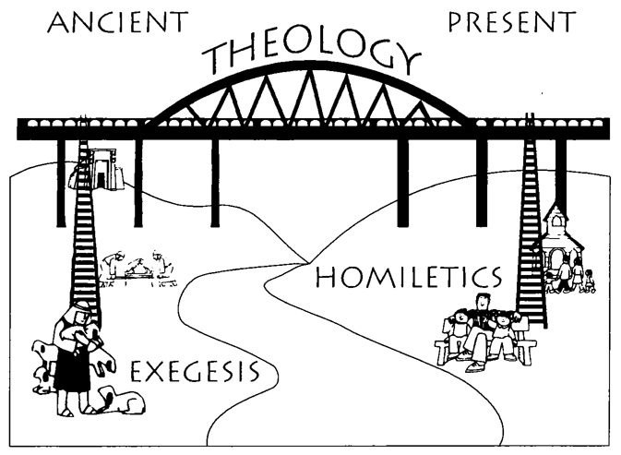
Preaching as bridge building
Willhite, Preaching With Relevance. 64.
Notes:
Slide# 10 Further discussion of preaching is bridge building. This picture comes from Keith Willhite’s book “Preaching with Relevance” If available hold up the book. Optional Student Activity: Bring in a ladder and have a interactive discussion about the “Ladder of Abstraction” in understanding how to braid build the bridge between exegesis and homiletics.
If deciding to use an actual ladder: when discussing the ladder of abstraction explain that we can move up and down from the most concrete to more abstract. So as you see the picture on the left, there is a shepherd. More concrete would be to say the shepherd was David. Moving up the ladder of obstruction would be shepherd, then even further up would be man, and further up would be human being, or thing. So to move down obstruction is to move for more concrete.
In this exercise ask for a sacred text story. An example could be the story of Joseph, however what you want to know is what specific part. Is it Joseph in the New Testament or Joseph in the Old Testament? Is Joseph with the coat of many colors or Joseph being sold in the slavery? or Joseph being the prince of Egypt? You need to decide where your going to start. Might just ask what passage or unit of thought?
From specific to abstract asking the question, why is this in the Bible? When you asked the question, Why is this in the Bible? You begin to build the bridge and get to theology. We’re not looking at application yet, but we’re looking at the question of why is this hear?
Maybe you decided the reason of the theology is the sovereignty of God or maybe it's the fact that God is in charge when we live a righteous life. Once you decide why, you begin to move across the bridge and then go from abstract to specific into our own day as you begin to discuss some ways to applying this idea. We moved from exegesis up more abstract Theology and then back down to homiletics. For more information on this idea see page 64 “Preaching with Relevance” by Keith Wilhite.

Slide 16

Feed MY Giraffes?
Spurgeon once commented, ‘Christ said,
“Feed my sheep. . .
Feed my lambs.”
Some preachers, however,
put the food so high
that neither lambs nor sheep
can reach it.
They seem to have read the text,
“Feed my giraffes.”’
Stott, 147.
Notes:
Slide 11
Allow students to read humorous Quote we begin to transition to the next section

Slide 17
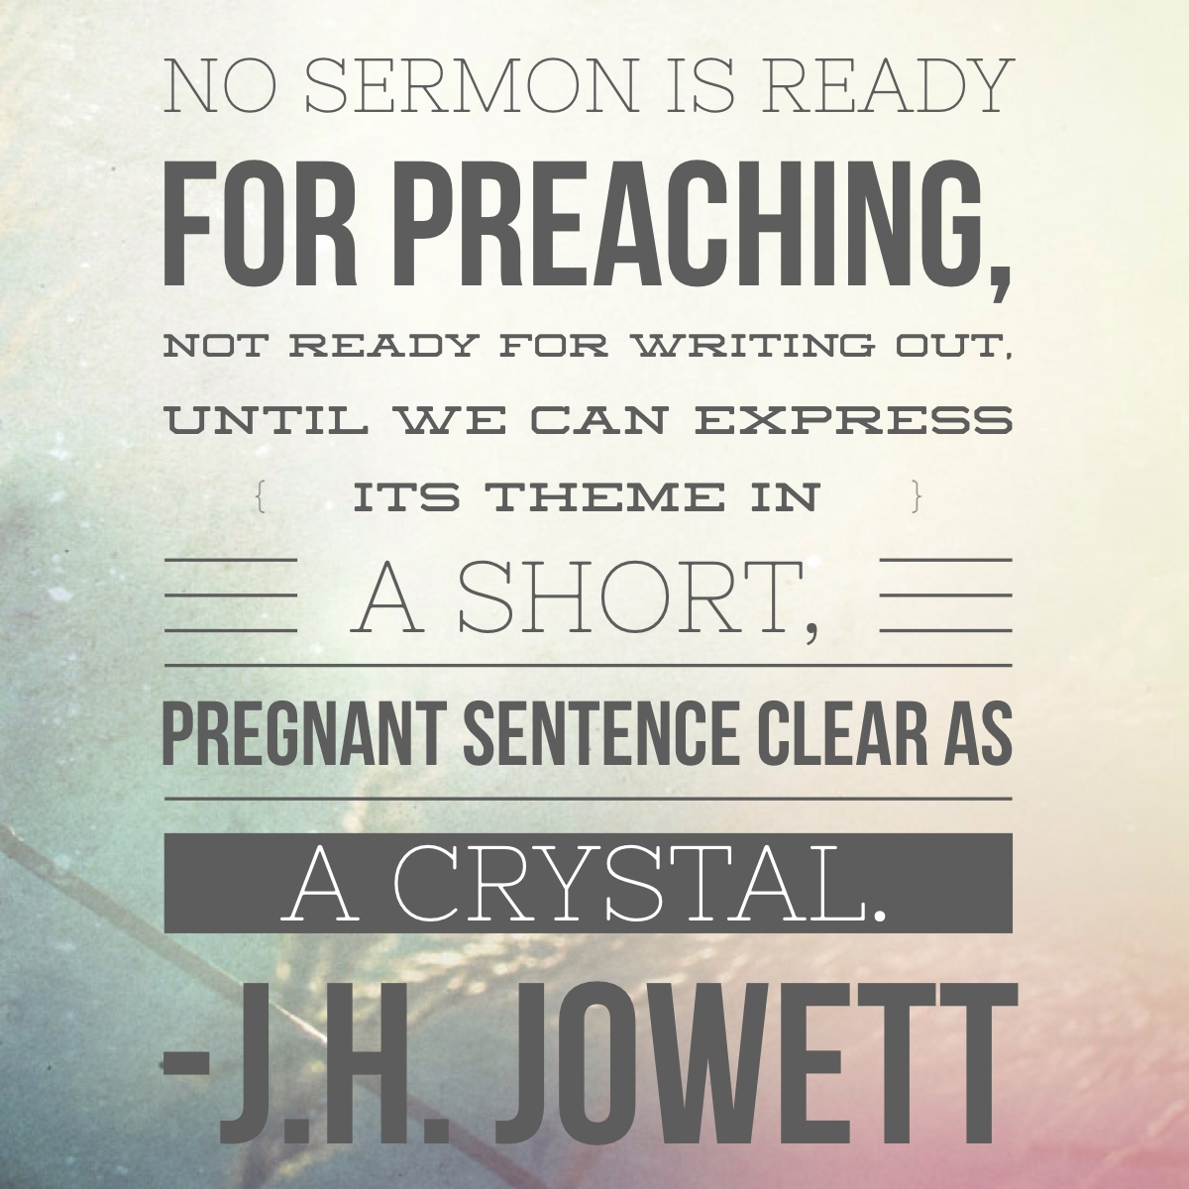
What’s The Point?
Notes:
LSA 2: Discuss the Importance of the Central Idea in preaching.
Slide 12 What’s the point? Allow students to read quote by Jowett and begin discussion on the importance of finding the main idea of the sermon. This starts LSA number 2.

Slide 18
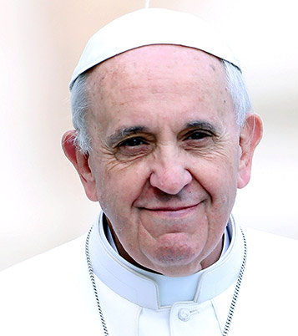
The Pope on Preaching
Our most important goal [in Preaching]
is to discover its principal message.
The message which gives
structure and unity to the text.
The central message is what the author primarily wanted to communicate;
this calls for recognizing not only the author’s ideas but the effect which he wanted to produce.
-Pope Francis
Notes:
Slide 13 The next few slides are quotes building the idea of the importance of the central idea of the sermon. Allow students to read and make brief discussions if necessary.

Slide 19
One Theme, Please!
  Sometimes the khatib (preacher/speaker) delivers his khutbah (sermon) without focus.
  One may say that he heard many good things, without knowing what the khatib wanted to say.
  A khutbah such as this is without THEME.
  For an effective khutbah FOCUS ON ONE THEME, PLEASE.
  Wael Alkhairo, Speaking for Change: A Guide to Making Effective Friday Sermons (Khutbahs), 47.
Notes:
Slide 14 This “furthers the discussion from an Islamic perspective, if available hold up the book “Speaking for Change”.

Slide 20

The Big Idea
A sermon should be a bullet, not buckshot. Ideally each sermon is the
explanation, interpretation, or application of a single dominant idea supported by other ideas, all drawn from one passage or several passages of Scripture.
Robinson, Biblical Preaching, 35
Notes:
Slide 15 There is a lot from the Robinson’s book, “Biblical Preaching” if available hold it up to explain the importance of this book in understanding preaching. Allow students to read the slide highlighting the importance of central idea, as well as the purpose. How the single dominant idea is supported by other ideas and then the purpose is the explanation interpretation or application of the idea.
Ask for thoughts and begin a discussion on the importance of the big idea.

Slide 21

Names for the Most important Sentence
Big Idea
Central Idea
Main Point
Dominant Thought (DT)
Bottom Line
Sticky Statement
Proposition
Take-Home Truth
Sermon in a Sentence
Theme
Idea Worth Spreading
Phrase that Pays
Viral Catch Phrase
Notes:
Slide 16 Throughout this lesson were referring to the central idea as being the most important sentence in the sermon ask for various names that they’ve heard of for this central idea main point big idea bottom line or theme.
The slide could be hidden and you can begin to ask, highlighting names they may have heard and ultimately emphasizing that this concept is most important to clarify the sermon.

Slide 22

Notes:
Slide 17 Asked these three questions to focus the message this is a good slide to take a break on and come back to as a transition to further discussion on how to develop the central idea.
Optional Student Activity: this is an area for an interactive activity using a dartboard. If desiring to do this activity, you must have a dartboard, some darts, some darts without feathers and a handful of thumbtacks. Have three volunteers throw the objects at the target starting with the thumbtacks, next the dart with no feathers, and the third the dart with feathers. This can illustrate a sermon with many points, one that’s not quite developed, and one with a point where the sermon was developed to hit the target.

Slide 23

What am I talking about?
Behind every subject there is a question either stated or implied. Robinson,41.
Notes:
Slide 18 This slide begins the discussion on developing the central idea again referred to biblical preaching Robinson’s book. Note: make sure students have a handout explaining how to find the point called “Basic Communication and Preaching Skills: Elements of the Sermon.”

Slide 24

Result of Choosing One Idea
Notes:
Slide 19 Discuss why Students think the central idea would provide focus for the sermon. The next few slides will begin testing the idea of formulating the idea

Slide 25
Forming the Idea
Subject ? (What am I talking about?)
Behind every subject there is a question either stated or implied.
-Robinson,41.
Notes:
Slide 20 The subject is focused to find a question at the heart of the passage.

Slide 26
Forming the Idea
Complement Answer
(What exactly am I saying about what I am talking about?)
It completes the Subject or answers the Subject question to form the Idea.
Subject + Complement = Idea
Notes:
Slide 21 The complement is the answer, taking the subject question further. It completes the subject and answers it to form the Central idea. Note on the slide the subject plus the compliment equals the idea.

Slide 27
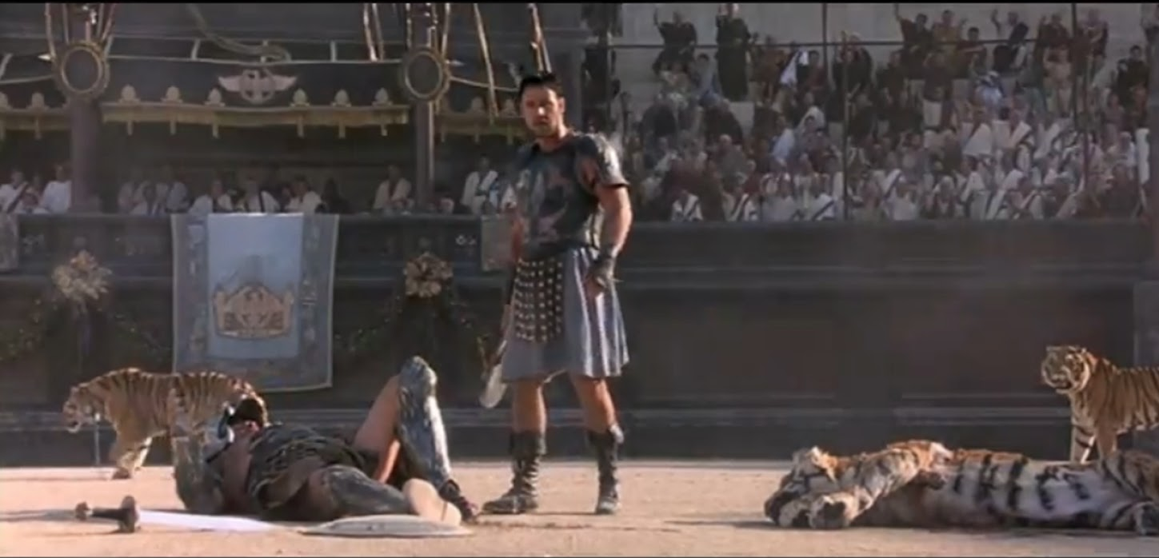
The Man in the Arena
Notes:
Slide 22 Classroom Activity: Use on Handout or show slide.
Quote from President Theodore Roosevelt and “The Man in the Arena.”
Give background to the quote and ask them to find the subject complement and central idea of the message.
Give students a few minutes to read over the quote and give the central idea. Ask for answers from the class.

Slide 28
The Man in the Arena
“It is not the critic who counts;
not the man who points out
how the strong man stumbles,
or where the doer of deeds
could have done them better.
The credit belongs to the man in the arena, whose face is marred by dust
and sweat and blood,
who strives valiantly . . .
Notes:
23-24 Man in the Arena quote

Slide 29
The Man in the Arena (Con.)
Who knows the great enthusiasms,
the great devotion; who spends himself in a worthy cause; who at the best knows in the end the triumph of high achievement and who at the worst,
if he fails, at least he fails while daring greatly. So that his place shall never be
with those cold and timid souls
who know neither victory nor defeat.” -Theodore Roosevelt

Slide 30
Student Activity
Subject + Complement = Idea
Try it. With “The Man in the Arena”
Subject (Question):
Complement (Answer):
Idea:
Notes:
25 In this practical exercise, ask students to try finding the subject complement idea with “The Man in the Arena” when the students have, ask the students for questions to help clarify this concept.

Slide 31
Student activity
Subject + Complement = Idea
Try it. With “The Man in the Arena”
Subject (Question):
Why does the credit belong to the man in the arena?
Complement (Answer):
He spends himself in a worthy cause and will know victory or defeat.
Idea: The credit belongs to the man in the arena, because he spends himself for a worthy cause.
Notes:
26 This slide shows a possible answer for the students. There are other possible answers but it must have the similar idea.

Slide 32
Student activity
Subject + Complement = Idea
Try it. Psalm 32:1-2
Subject (Question):
Complement (Answer):
Idea:
Notes:
27-28 This is another student activity for Psalm 32:1-2 to give the students more practice, if time allows add other passages for practice and let the students know they need to try this with the passage they are planning to preach.

Slide 33
Student activity
Subject + Complement = Idea
Psalm 32:1-2
Subject (Question): Who does the psalmist say is a blessed person?
Complement (Answer): The honest individual whose sin the Lord has forgiven,
Idea: A blessed person is one who’s sins are forgiven.

Slide 34
Crafting a Sticky Statement
P – Is there a word PICTURE or metaphor?
Ex. You are the light of the world
R – Can I use a RHYME to make it memorable?
Ex.. I before E except after C
E – Can I ECHO words or phrases to help it stick?
Ex. Forgiven people forgive
A – Will ALLITERATION drive it home?
Ex. Your soul is more important than your stuff
C – Can I CONTRAST two phrases, words or ideas?
Ex. Whoever finds his life will lose it
H – Is there a HOOK you can repeat again & again?
*From SermonCraft, by preachingrocket.com
Notes:
Slide #29 Crafting a sticky statement, Once you have the main idea of the passage How do I make it memorable? The acronym preach helps give ideas to crafting a sticky statement.

Slide 35
How to Deliver a TED Talk
A well-built catch phrase is a short, action-centric, and rhythmic distillation of your idea worth spreading.
With a compelling, laser-focused single unifying message packaged into a catch phase that makes it viral, you will have entered the upper echelon on speakers.
-Jeremey Donovan, 80.
Notes:
Slide #30 The slide from “How to Deliver a Ted Talk”, explains the importance of the central idea. Allow students to read, highlighting the underlined portion.

Slide 36

Examples of sticky Statements
When People are a priority God receives Glory.
(Sermon preached on Fellowship, Acts 2:42-42 )
A Fool Consumes Relationships
like Cake, but the Wise invest in them.
(Sermon preached on Proverbs regarding relationships)
An Attitude of Gratitude Honors God.
(Sermon preached on 10 Healed lepers, Luke17:11-19 )
What are other examples?
Notes:
Slide #30 The slide from “How to Deliver a Ted Talk”, explains the importance of the central idea. Allow students to read, highlighting the underlined portion.

Slide 37
Putting it together
Take your passage for your sermon
Subject (Question):
Complement (Answer):
Idea:
Apply PREACH to make sticky.
YOUR
IDEA HERE!
Notes:
Slide #32 The slide puts all the ideas together. Assign this to the students to get started with what they’re going to work on with their sermon. Note: Use yellow Post-it notes to hand out to students. This will help them remember the assignment and write their central idea on note.
**This is a good place to take a break before transitioning to the next section.

Slide 38
Structure
How do you want to present the idea?
What will the shape of the sermon take?
Examples
Deductive, Inductive, Hybrid, Subject Completed
Notes:
LSA 3: Discuss Message/Sermon Structure.
Slide #33 LSA 3 discuss the message sermon structure. Discuss the four types of message structures and allow some discussion of from the students.

Slide 39
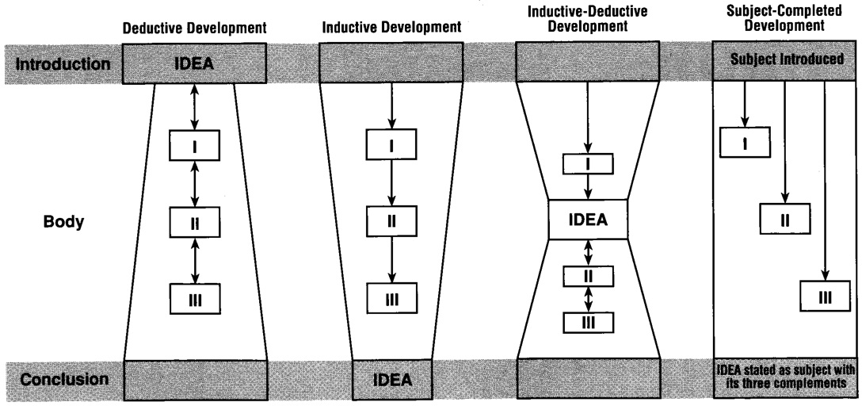
Four basic forms
-Robinson, 79.
Notes:
Slide #34 Explain the 4 basic forms of message discuss each of them and give examples.

Slide 40
Small group Activity
How will you support your idea? Try it.
Man in the arena
Idea: The credit belongs to the man in the arena, because he spends himself for a worthy cause.
Made sticky: The one who strives, survives.
Psalm 32:1-2
Idea: A blessed person is one who’s sins are forgiven.
Made sticky: The Blessed is the one who’s Confessed.
Notes:
Slide #35 Classroom activity: Using the main idea from the quotation “The man in the Arena” we used earlier from President Roosevelt or Psalm 32 How would you structure a message to communicate the idea to an audience. This is a small group activity break group into groups of three or four.

Slide 41
The Big Idea
A mist in the pulpit is a fog in the pew.
If the speaker has no point the listeners will miss it every time.
  Craft a compelling Idea from your sacred book and present it with clarity.
Those who listen will be blessed and respond.
Notes:
Slide #36 This is a summary slide for explaining the importance of central idea. Note: the slide is not needed but the instructor should convey the points that are made.

Slide 42
The Importance of Purpose
So What?
Who Cares?
What Difference does it make?
Notes:
LSA #4: Discuss the Importance of Purpose to the Message
Slide #37 This slide begins LSA number 4. Discuss the importance of purpose for the message. If the sermon has no purpose listeners will have various questions as they leave. Discuss other questions the listener may have.

Slide 43
Purpose of Sermon
Ask the question as a result of this message I want my listeners to __________?
Now what?
Know/Head
Be/Heart
Do/Hands
Notes:
Slide #38 To find the purpose of the sermon ask the question, “as a result of this message, I want my listeners to (fill in the blank). The answer to that question is what you’re trying to accomplish in the sermon. One way, I like to explain is “When you give them the now what, they will not ask so what.” Note: This is on the backside of the elements of the sermon worksheet.

Slide 44
Purpose of Sermon
A purpose differs from the sermon idea,
in the same way
a target differs from the arrow;
as taking a trip differs from studying a map; as baking a pie differs from reading a recipe.
*The IDEA states the truth, the PURPOSE defines what the truth should accomplish.
-Robinson, 72.
Notes:
Slide #39 The slide is a quote from “Biblical Preaching,” Robinson page 70. Allow students to read and ask for feedback.

Slide 45
Purpose of Sermon
Three Developmental Questions
1) What does this mean?
2) Is this true? Do I believe it?
3) So What? What difference does it make?
-Robinson, 67.
Notes:
Slide #40 This slide introduces three developmental questions, which help to refine the purpose of the sermon.

Slide 46
Setting the Objective of the Khutbah (Sermon)
Am I going to persuade the audience to espouse a new idea, correct certain misunderstandings? Or Am I going to spiritually inspire, inform, or mobilize the audience for a certain action?
-Wael Alkhairo, 41.
Speaking for Change: A Guide to Making Effective Friday Sermons.
Notes:
Slide #41 Allow students to read quote from “Speaking for Change” an Islamic perspective.

Slide 47
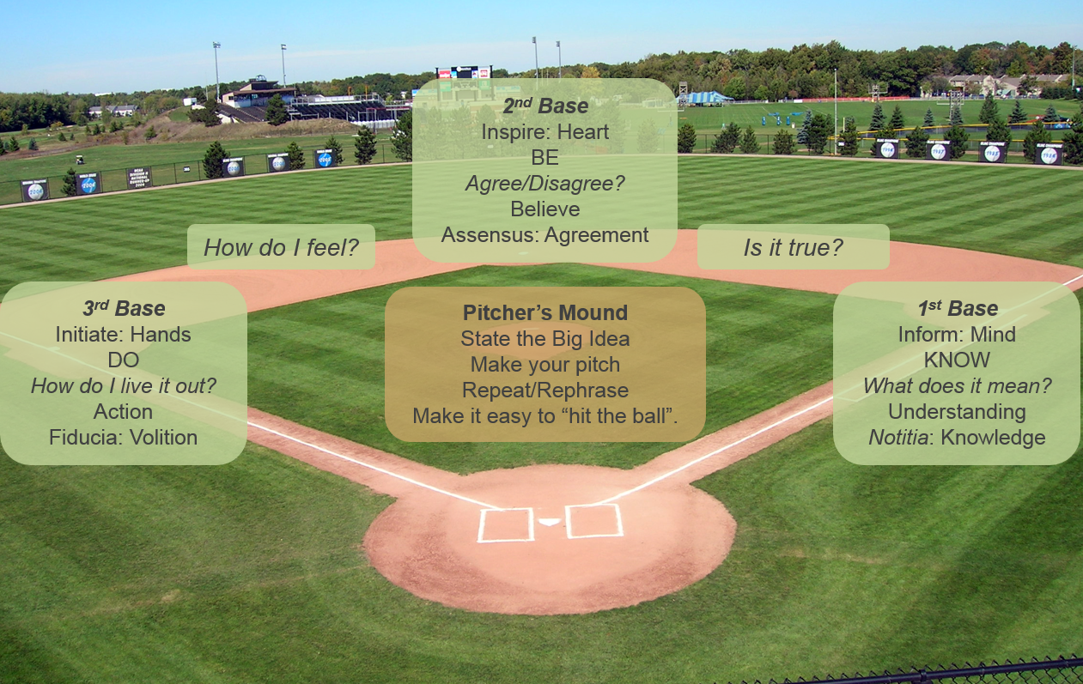
Running the Bases
Notes:
Slide #42 The slide “Running the Bases” is a visual representation of putting it together the points in the purpose. Explain the concept of running the bases as a progression in the purpose of the message. Start with the preacher as the pitcher throwing the pitch or stating the idea to the listeners, rephrasing and explaining it so the listeners can make a hit. Once the listener understands the idea, then you need to decide if first base, second base, or third base is the area of focus pasted on what you are trying to do with the idea. Discuss how to bring the Listener from information, to inspiration, to initiation, or the idea from the mind, to the heart, to the hands.

Slide 48

Elements of Purpose
Notes:
Slide #43 This next slide is another visual on the elements of purpose. The question, to ask is, “what am I (or the text) trying to do with this message (or Idea)?” At the bottom (the pic illustrates) we first must engage the listener. Then ask, “Am I trying to inform them, or am I trying to inspire them?” This graphic is from Professor Kenton Anderson, he explains the reason for the engage at the bottom and convict at the top, is that we are to engage as preachers but God is the one that does the convicting. Ask question, do you think this is true?
I think this is true. Have you ever heard a preacher try to convict? It feels like manipulation and makes it seem like you’re just Car salesmen.

Slide 49

Putting the Pieces together
Notes:
LSA #5 Discuss putting the pieces together
Slide #44 This slide begins LSA number five and discusses putting the pieces of the sermon together. Ask the students to review what has been learned up to this point? Then ask, “What else is needed to complete a sermon?” We have the point, we have the purpose, we have the biblical text, but what else is needed as elements of the sermon?

Slide 50
Tips for Illustrations
Ask the questions,
  “What am I illustrating?”
  What is the best way to support the point I am making?
  What makes an illustration powerful?
  What are ways to illustrate based on my point and purpose? (ie. Personal Story, news clip, video)
  Is the illustration too powerful or does it distract from my point?
Notes:
Slide #45 discuss tips for illustrations and the difference between an illustration and a distraction. The tool to illustrate must support and shine light on the “Central Idea” if not it is a distraction and should be thrown out.

Slide 51

Tools for Clarity
Notes:
Slide #46 Tools for clarity: discuss the various tools that can be used based on what we’re trying to do. We must understand the purpose of the illustration. Ask students, Why they would choose to use a picture versus story versus a problem versus an idea?

Slide 52
The Beginning and The end
Introductions and conclusions have significance in a sermon out of proportion to their length. Robinson,165.
Do you think this is true? Why?
Notes:
Slide #47 The slide introduces, beginning and ending of the sermon. Have students read “and explain if they believe this quote is true and why.

Slide 53

Intros & Conclusions
On ramp and Off ramp to the Sermon
Notes:
Slide #48 Discuss the idea of the intro and conclusion as being the on and off ramp to the sermon not the destination it’s just the way that we get to the idea get to the essence of the sermon as well as get off and the message.

Slide 54

Introductions
How to Start?
State the central idea
Lead into the first point
Command attention
Create tension
Surface need/ desire to listen
Notes:
Slide #49 The slide discusses introductions. Discuss the points on the slide and open up to other questions or comments about the introduction of the sermon. Note: After listening to many sermons it is my experience that often the introduction is longer than it needs to be. Develop desire to listen and transition to main point.

Slide 55

Conclusion
Summarize
Use of Illustration to focus point
Provide a sense of finality and challenge
Do not introduce new material
Notes:
Slide #50 Discuss the conclusion of the sermon. Highlight the four points on the slide. Emphasize the last point and have students repeat it, "Do not introduce new material!”

Slide 57
Check on Learning
Putting it all together
Central Idea
Structure
Purpose
Illustrations
Introduction
Conclusion
Notes:
Slide #51 This slide is a wrap up of all that was taught in this lesson. Ask the students to reflect on the topics what it would look like to put it altogether. As you go

Slide 58
Terminal Learning Objective (TLO)
ACTION: Conduct Religious Services in various military settings according to faith traditions.
CONDITIONS: In a classroom environment, given classroom discussion, student handouts, student activities, assessment rubric and homework assignment.
STANDARD: The student will have met the standard when they have written a 2-page summary and present a message based on Sacred text according to their faith tradition.
Notes:
through the list request feedback on each specific point giving something that they learned in this lesson.
Note: let students know that they should be working on their sermon for the field service and/or student chapel lab using the form given to create a 1 to 2 page sermon summary.
Note for this lesson add slides called BCAPS 4 hour.
1: handout for CHOBOLC: Basic Communications and preaching skills Elements of a Sermon.
1: one page summary sheet example 1st Corinthians 4:1-12 and a blank example.
1: Add communication coaching form (CCF) and communication self-evaluation form (CC SELF) and communication coaching short form (CCSF).

