Slide 1
Analyze Pastoral Presence in Sacred Communication
CH (MAJ) Brandon Moore
Homiletics SME, USACHCS
Notes:
Notes for Lesson 1: Analyze Pastoral Presence in Sacred Communication
Task 85D-201-8014 Perform Supervision of Sacred Communication (updated Evaluate Sacred Communication) C: Level 5
Slide 1
Attention: No one intends to preach a bad sermon, it just comes naturally. ☺
*Attributed to St. Francis of Assisi, “Preach always if necessary use words”
Motivation: today we are going to talk about, How the person is the foundation for the presentation.
The bottom line for today’s lesson is “If you were jerk and a good preacher you’re still a jerk!” Who you are and how you present yourself has more of an affect on what you say than what you think. So today, we’re going to examine and explore the X factor of Sacred Communications. Truth is that if you miss this, missed everything. You must understand that you are an integral part of the message that you give.
In the Book “You are the message, Rogiles states that the first 7 secs are key.
First impressions we communicate with our eyes, faces, bodies, and attitudes.
Research shows that the 80 muscles of the face are capable of making more than 7000 different facial expressions. Sadly many of us have been taught that having a poker face gives you a strategic advantage. In some cases but not in Oral communication.
Let’s practice. Not verbal communication 101: it is called the smile ☺
Note: based on time and feel of group instructor can go through other facial expressions and have class try them.

Slide 2
Terminal Learning Objective (TLO)
ACTION: Analyze Pastoral Presence in Sacred Comms
CONDITIONS: Given pre-reading, classroom instruction in a classroom setting.
STANDARD: Analysis includes:
*Distinguish ways a Presenter affects the Presentation
*Compare Pastoral Metaphors
*Simplify and explain personal calling
*Examine Spiritual practices IOT develop Pastoral Presence
Notes:
Slide 2
TLO slide 2 and 3 are the TLO slides
Discuss action conditions and standards, what’s expected

Slide 3
Administrative Data
Safety Requirements: NONE
Risk Assessment: LOW
Environmental Considerations: NONE
Evaluation: NONE
Notes:
Slide 3
Safty:
Risk:
etc

Slide 4
OverView
Distinguish how a Presenter affects the Presentation
Compare Pastoral Metaphors
Simplify and explain your personal calling
Examine Spiritual practices as development tools
Notes:
Slide 4:
Overview
Bullets on the slide are the key areas we are going to look at today.
Begin to discuss those LSA’s with class.
The overall goal for our sacred communication blocks are to.
Develop the Chaplain’s Skill to coach and mentor others for greater effectiveness in Sacred Communication.
The tools that we will use are
The Speaker Assessment Cycle (SAC)
& Communication Coaching Form (CCF)

Slide 5

Foundational Questions
*How do you define Pastoral Presence?
*What is Sacred Communication?
Notes:
Slide 5
Lead in:
As we start analyzing Pastoral presence and Sacred Communication, There are two key questions, we need to discuss as we define terms.
*How would you define pastoral presence?
Let group answer and respond.
(Answers can include sincerity, empathy, conviction, enthusiasm, connection, authenticity, caring, engaging, and approach.) See CCF
*What is sacred communication?
Let group answer and respond. (Answers can include but are not limited to, preaching prayer funeral message speech class.
Sacred Communication encompasses any public communication given by a chaplain.
The two specific examples will focus on the most in this class are: The sermon and the funeral message.

Slide 6
A Model for Developing Sacred Communication
Leadership Lens
ADRP 6-22
Development Model
Skill Level
Supervision
Coaching
Basic
Sacred Comms Skills
Theological Integration
Model for Funeral Messages
The Identity of the Sacred Communicator
Achieves
Develops
Supervisory Chaplains
COMPETENCIES
Leads
Intellect
ATTRIBUTES
All Chaplains
Character
Presence
Notes:
Slide 6
LSA 1: Distinguish ways a Presenter affects the Presentation
Slide 6-9 Show how Person relates in the larger picture of Evaluating Sacred Comms.
Army doctrine begins with the profession and the leader. At the heart of leadership is the character and presence of the individual. In older leadership manuals, this was expressed as BE-KNOW-DO. Today, Leadership Attributes and Competencies work together on the inside to aid the individual in influencing others toward organization goals and mission accomplishment. Effective ministry begins with the person and identity. KNOWING what to DO is only as effective as the presence and character ( who they are (BE)).

Slide 7
Speaker Assessment Cycle (SAC)
Person – Soul - Formation
In what ways did the speaker add to or distract from the message?
Preparation – Skill - Information
Did the message reveal preparation & clear concise thought?
Presentation – Sermon - Evaluation
Was the message contextually relevant, within time constraints, & did it accomplish its purpose?
Feed Back
Coaching
1) Presenter (CC-SELF)
2) Supervisor (CCF)
*Verbal & Non-Verbal
*What was the overall impact?
Notes:
Slide 7
Speaker Assessment Cycle. (SAC) is a tool to help in assessing areas of a message to identify areas for development in Sacred Communication.
The first section, and the area were going to be focusing on today is the person, the soul, and formation. See how the person starts and continues later on you can see preparation and presentation will look at those in future lessons.

Slide 8
Speaker Assessment Cycle (SAC)
Person -What’s going on with me?
*Life Situations
*Spiritual Formation
*Self-Care
Preparation - What am I going to say?
*Textual Study
*Manuscript/Outline
Presentation – What was said?
*From Written to Oral
*Delivery (What/How message was heard.)
*Coaching Feedback Loop
Notes:
Slide 8
The slide elaborates on the speaker assessment cycle. Take some time to discuss the 3 areas with students.

Slide 9
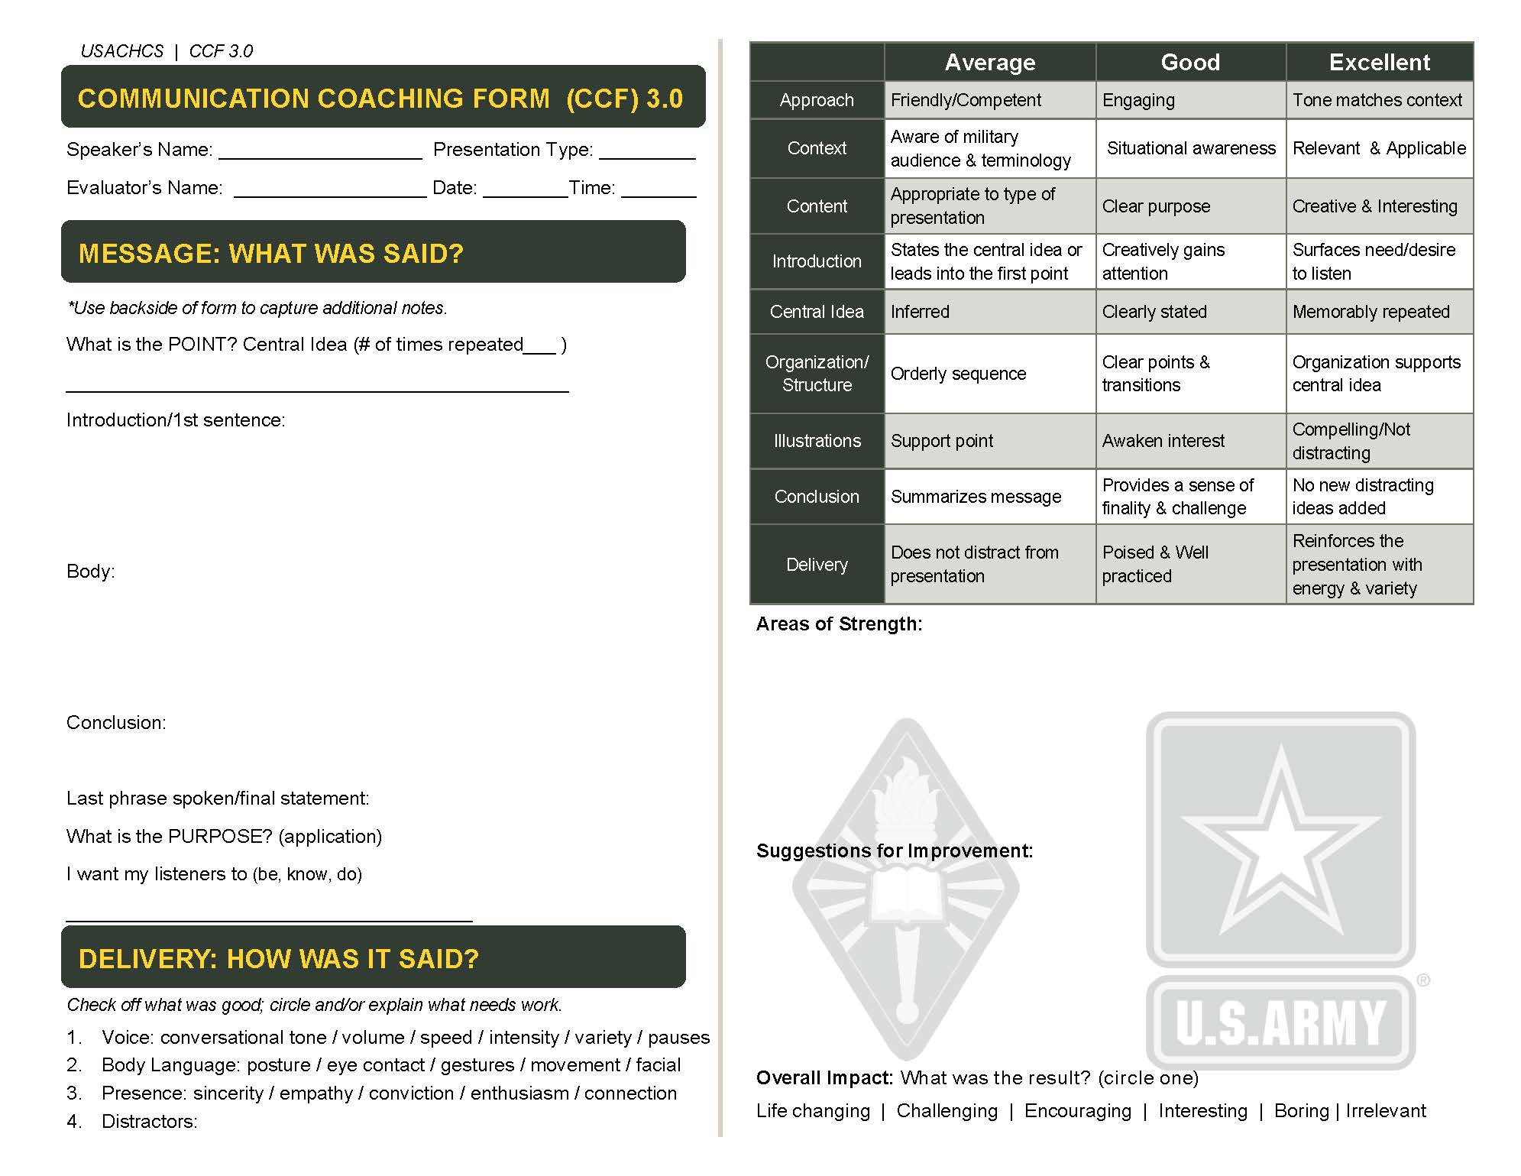
Notes:
Slide 9
The communication coaching form (CCF) is the foundational form used for evaluation of Sacred Comms. It will be looked at through all lessons as well as used by each student in chapel lab.
Note* Pass out the CCF to the students so they can get familiar with them.
NOTE: The sections circled in yellow specifically correspond with the lesson today “Analyze Pastoral Presence.” Highlight those sections and discuss briefly.

Slide 10
Foundational Questions
*How does the Person affect message?
*Do you have a favorite speaker/preacher you listen to?
Notes:
Slide 10
Ask and discuss both questions?
“How does the person affect the message?”
Note: Have students to give specific examples both positive and negative.
For the next question, (Ask, Pair, Share) I'd like you to break into groups of two and discuss with your partner your favorite speaker/preacher. Explain why you like listening to them and then come back as a group and let your partner name and explain your speaker to the group. 2 min give name and explain why?

Slide 11
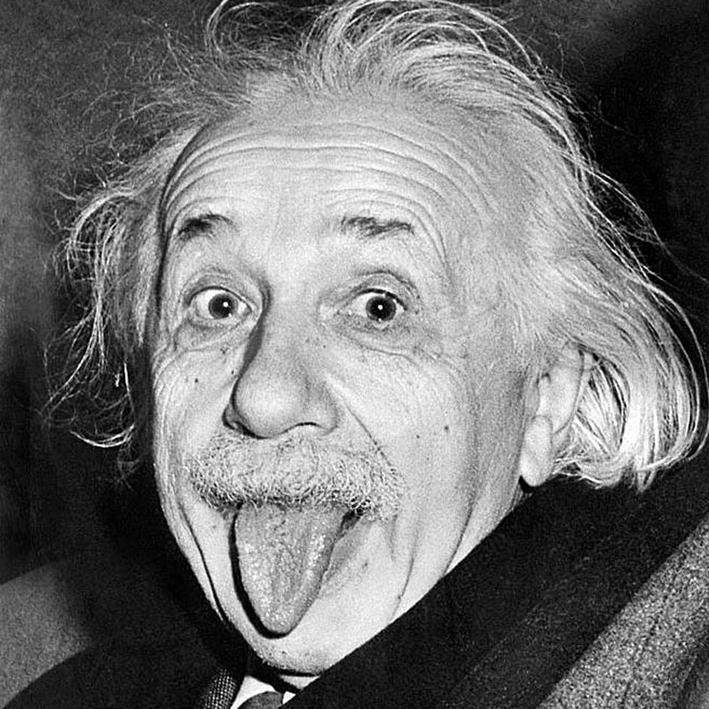




“Just Be Yourself”
Adam Grant
When we’re looking to change our game, a too ridged self concept becomes an anchor that keeps us from sailing forth.”
Pay attention to how we present ourselves to others, and then strive to be the people we claim to be.
Brene Brown
Authenticity: The courage to be imperfect
To be vulnerable & to set boundaries.
Notes:
Slide 11
Just be yourself
I heard about this article in a podcast by Michael Port called, “steal the show”. Read quote from chapter 1 “Find Your Voice” page 5 “Finding your voice is important for your results. If you want to play different roles authentically an amplify or downplay different parts of your personality to do so, it’s important to be comfortable with who you really are and what you stand for so you never lose sight of your values.” Chapter 2 “Play the right role in every situation.” If time allows and it fits with discussion share quotes from p. 13-15.
What did you think about the pre-read article?
Adam Grant says it’s not good advice to be yourself. When you think about the idea of authenticity and people say just be yourself, what do you think that means in public communication? What do you think about the discussion between Adam and Grant and Brene Brown?
Leave class with this question before the go on break:
**When we think about this idea, of the person affecting presentation, how does being yourself and authenticity fit it? How about in Analyzing Pastoral Presence?

Slide 12

Calling: Why Preach?
Find a Metaphor for Ministry
Notes:
Slide 12
LSA 2: Compare Pastoral Metaphors
Highlight a few books and quotes
-Ted Talks p 198 The person is “the added layer that turns information into inspiration. Examples –connection, engagement, curiosity, understanding, empathy, excitement, conviction, action.”
You are the message p32-33 “You just have to be yourself at your best. The truth is you already have the magic of good communications within you, because nobody can play you as well as you can. . .The trick in good communications is to be consistently you, at your best, and all situations.
Choosing to Preach, p. 12,
Preaching is a choice. No one demands it of us. If you will be disappointed if we choose to go another way. The only problem is that some of us who got his chosen can’t escape the sense that we have been called to preach.
p. 15 preachers today are expected to be his deepest Saint Augustine, as practical as Billy Graham, and as entertaining as Jay Leno. If a preacher does not possess all these qualities listeners can easily find one who does, if not down the street than certainly on television on the Internet. Or they might choose not to listen to preaching anymore at all.
Deep Preaching, page 37 Preaching is incarnational the very best way to communicate a message just to do it do so in person. Why is incarnational communication so effective? Sermons given in person or laden with personal credibility incarnational communication is audience adaptive your presence gives evidence of how valuable you think your audiences is.
Ask ? to set up next section.
What is calling? How would you define it? (give class a few min to respond before moving to next slide.

Slide 13
Calling:
Where God’s Purposes meet Your Passion
“Calling is the key to tracing the storyline of our lives and unriddling the meaning of our existence in a chaotic world.” Os Guinness
“The place God calls you is where your deep gladness and the worlds deep hunger meet.”
Fredrick Buechner
*Finding a Defining Metaphor
Peter: Fisher of Men (LK 5) or Feeder of Sheep (Jn 21)
Notes:
Slide 13
Define calling: Where God’s purposes meet your passion. It is an aspect of what God is calling you to do and deep inside what you feel like you’ve been made for.
Take a look at the definitions as you think about call. Is there another way that you would explain this concept other than call? another word? Metaphor?
I believe that a call to follow requires a defining metaphor. Have you ever thought about a metaphor that helps you understand your meaning, your purpose in life?
Let me illustrate with the story of Peter. Peter the first disciple was called to follow
First as a Fisherman, next as a shepherd. I think there are times as we grow and mature that we must find a new image or metaphor to hold on to, to help us through.

Slide 14


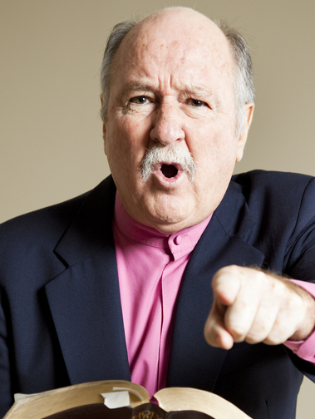

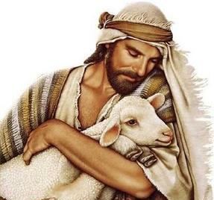

What Metaphor would you use?
Notes:
Slide 14
Have students look at the six images, then walk through them and apply them to the person of the preacher. Have students discuss the positives and negatives about these metaphors as they think about them. Ask them if they have heard a sermon from this perspective and ask if it is all bad or if there is a positive aspect to this image?
Note: Hold up the preachers portrait by John Stott.
John Stott looks at the Bible to form a picture of the pastor. He identifies five metaphors. 1. the steward, 2. the herald 3. the witness 4. The Father 5. The servant.

Slide 15
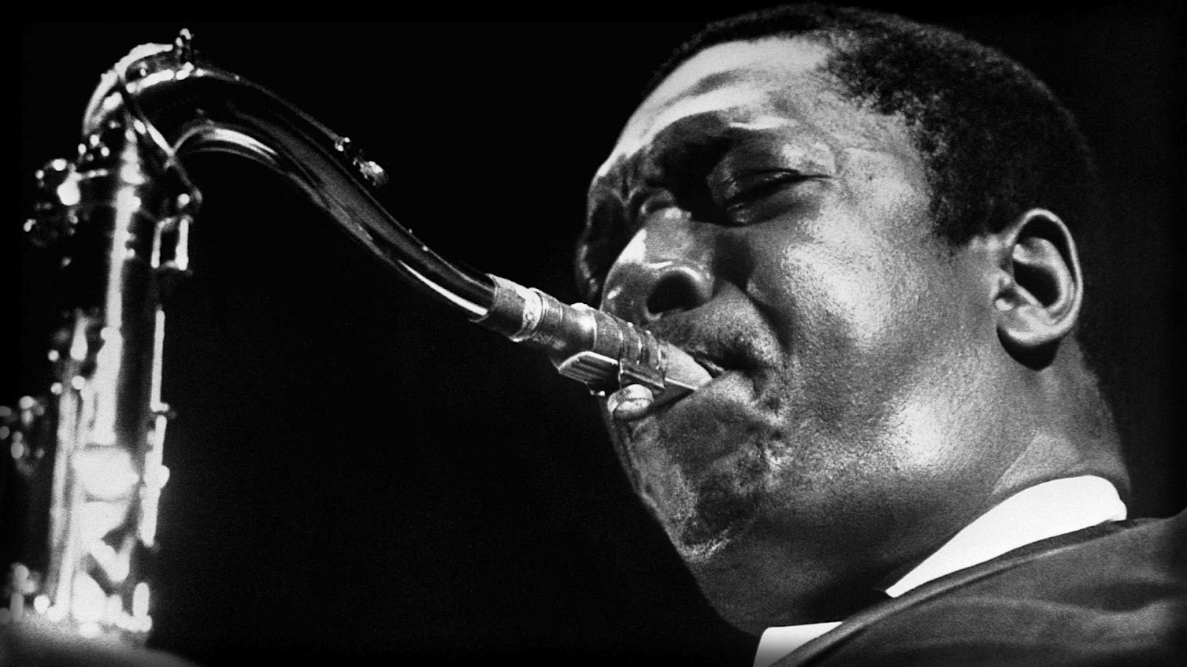
An Instrument in God’s Hands
Notes:
Slide 15 Find a personal image or metaphor
Note: Instructor can think of there own metaphor to give and explain.
Mine is “an instrument in God’s hands.” Does anyone know the name of the person in the picture? It’s John Coltrane, a master.
Optional: Have a saxophone as a visual and or play a song by John Coltrane.
Explain what the image means and get any feedback.
The key to a calling metaphor is that it is personal to you. It makes sense to you. You can hold on to it for encouragement and it provides focus for your call.
Ask class if they have thought of any metaphors?

Slide 16
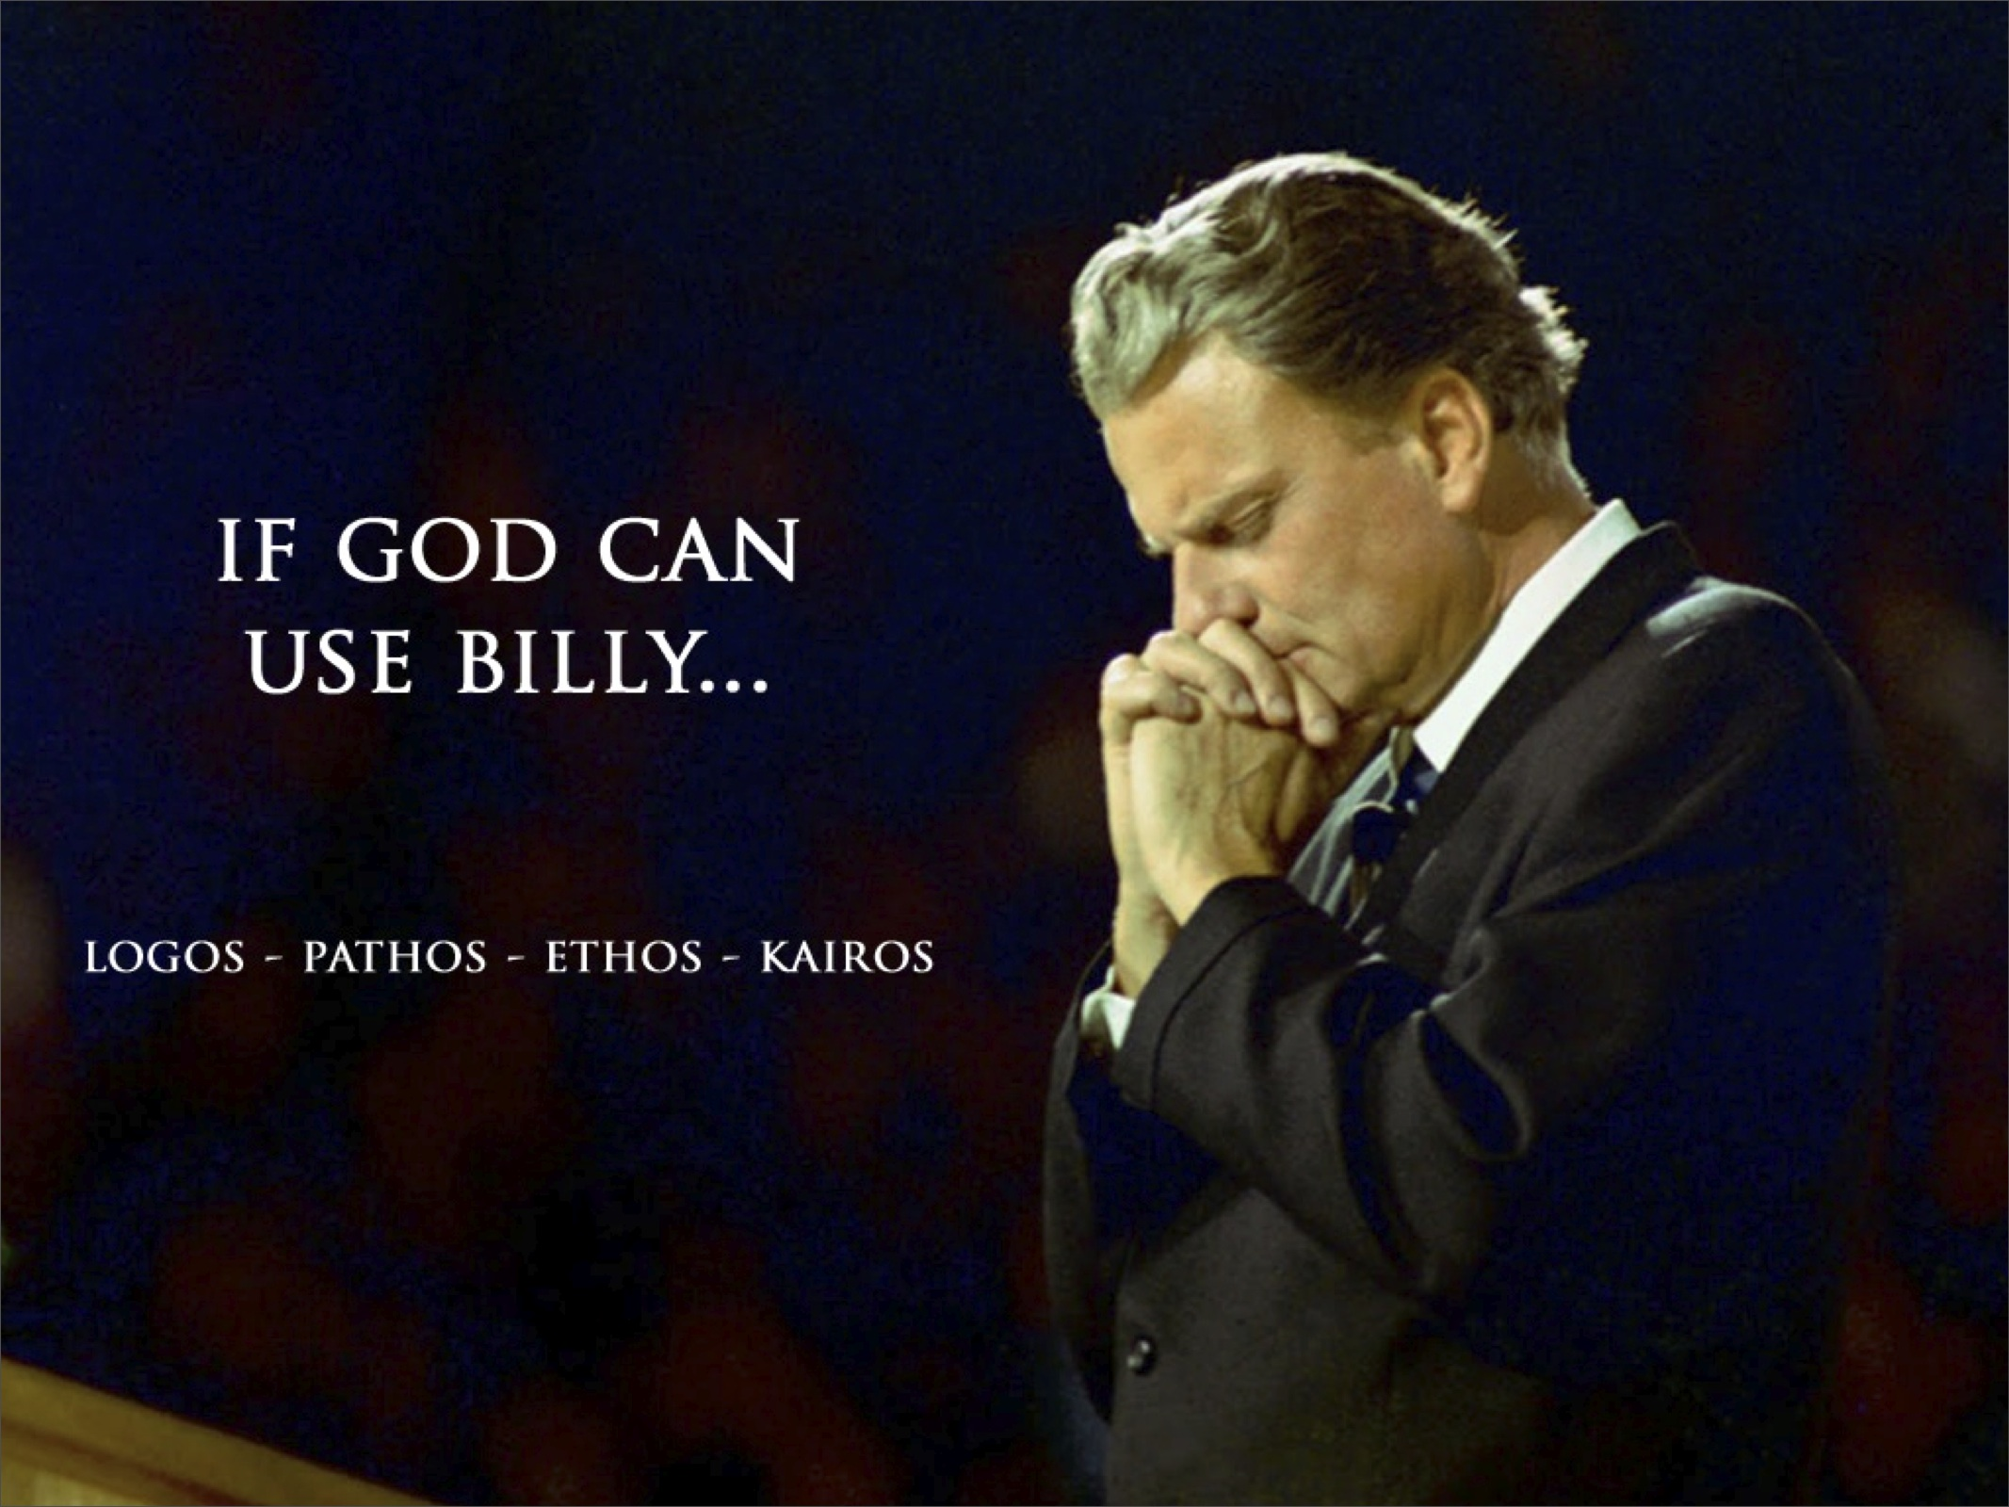
Notes:
Slide 16 As we look at this idea of pastoral presence in Sacred Communications and the person of the preacher,
One person comes to mind for me, is Billy Graham.
Have you ever been to the Billy Graham museum? In Charlotte North Carolina explain about the museum.
The rhetorical question is if God can use Billy? than God can use me.
The 4 words on the screen are 4 Rhetorical appeals that create a persuasive presence.

Slide 17
Rhetoric: Art of Persuasion
4 Rhetorical Appeals
You are the Chaplain at this place and time to teach this Word to these People.
What do they need to hear and how will you present it?
Ethos: Credible
Pathos: Emotion
Logos: Logic
Kairos: Time
Notes:
Slide 17: 4 Rhetorical appeals
Note: walk-through and discuss the four topics
Ethos: Ethics, Credible, Character Are they Good?
Pathos: Passion, Emotion, Empathy, Do they Care?
Logos: Logic, Is this True? Do they know what they are talking about?
Kairos: Time, relevant, Is this important? I must do something with this.
End with the last question prior to the break.
Note: a lot of more discussion can be made if time allows regarding Aristotle and understanding rhetoric and the keys to persuasion.
With the rise in popularity of TED Talks founder Chris Anderson explains the need for “Presentation Literacy” and bringing Rhetoric back to education.

Slide 18
Simplify and Explain Your call
How did you know you were called?
-Ministry and Military?
How does preaching fit into your call to ministry?
Take 5 min and write answers on a card, then we will discuss as a group.
Notes:
Slide 18
LSA 3: Simplify (5 Min) and explain your call to the chaplaincy.
Have you ever been asked the question by a soldier, “Hey chaplain, why did you decide to become a Chaplain?”
Take a few minutes and reflect on these questions, How did you know that you were called? Both to the ministry into the military. How does preaching, fit into your call to ministry?
Take five minutes and write down answers on the card then we’ll discuss as a group.
Note: Have a timer so as to keep each person to five minutes.
Instructor will model by going first answering their own question. Then allow students to volunteer and allow everyone to have a turn.
This will probable take 2 hrs. take a break for lunch and finish up after lunch break.

Slide 19

Pastoral Presence is the integration of the whole Person
Notes:
Slide 19
LSA 4: Examine Spiritual practices regarding development of Pastoral Presence
Options: Have spiritual formation books to give to students for spiritual growth tools. If resources are available have various books that students can choose from to take for their own personal growth. If resources are unavailable bring some examples to show from the library or from instructors personal library as examples.
Another option is to have a guest instructor come in and discuss the importance of integration of spiritual disciplines soul care and self-care. Choose a guest instructor, who is this subject matter expert in spiritual disciplines and that has a strong Pastoral presence to model and encourage the students. This person can also be a resource for the students outside of the class.
The goal of this session and LSA is to focus on spiritual practices and give some concrete examples for development of the person. Providing practical tools an opportunity for students to interact with another expert is key.

Slide 20

The Cultivation of the Person will
the Message!
Notes:
Slide 20: cultivation of the person will amplify the message. Pastoral presence is key to Sacred Communication.
Note after expert has left, instructor will close out this LSA through clarifying questions and giving a and inspiring example.

Slide 21
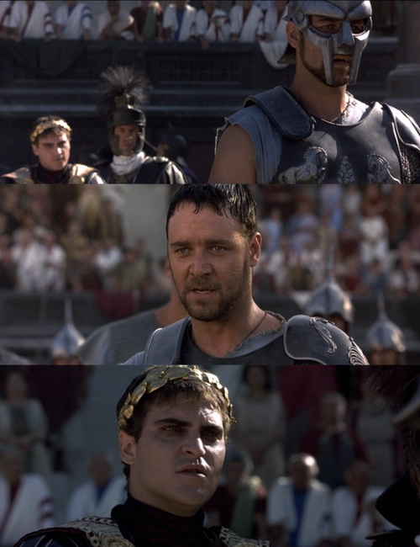
What’s Your Name?
Notes:
Slide 21: Optional example: Gladiator Helmut
Use the movie gladiator as an example to inspire the importance of the person to find their voice into and they’re calling. Ask class that ever seen the movie gladiator? Begin to describe the main character Maximus and the key scene in the movie where he is comes face-to-face with the emperor if available use the help use a helmet as a prop to describe knowing who you are and standing up and speaking the truth in sick communications.
Never forget your name! Remember who you are!

Slide 22
SUMMARY
What we covered today:
The IMPORTANCE of
Pastoral Presence in Sacred Communication
Ways the presenter affects the presentation
Pastoral Metaphors and connection to calling
Cultivation of the person as foundation for the message.
Notes:
Slide 22: Summary highlight all that was covered today and ask one last time for any clarifying questions.

Slide 23
Terminal Learning Objective (TLO)
ACTION: Analyze Pastoral Presence in Sacred Comms
CONDITIONS: Given pre-reading, classroom instruction in a classroom setting.
STANDARD: Analysis includes:
*Distinguish ways a Presenter affects the Presentation
*Compare Pastoral Metaphors
*Simplify and explain personal calling
*Examine Spiritual practices IOT develop Pastoral Presence
Notes:
Slide 23
TLO slide

Slide 24

Assignment before next Class
Watch 1 Talk
http://www.ted.com/playlists
Take notes
Why you chose this talk?
Briefly explain talk
Speaker (Name) style + or -
Topic
Main Idea or Point
Purpose: Why are they giving the talk?
Best part about talk
An area of improvement
Notes:
24: Assignment before next Class
Prior to next class analyzing the elements of sick communications have each student go to Ted.com and choose one talk to listen to. They should take notes first why they chose this particular talk and second explain the talk in the explanation they should give the speakers name describe the people the speakers style or presence what was the talk about identify the main point identify the purpose why they giving the talk and what was the best part of the talk will need to bring those notes to class will begin discuss those the beginning of the next class.
Optional if resources are available give out strengths-based leadership to each student so they can take the strength finders assessment for some self development.

