Slide 1
Analyze Elements of a Funeral Message
CH (MAJ) Brandon Moore
*Homiletics SME, USACHCS
Notes:
Slide #1 Task 85D-201-8014 Evaluate Sacred Communication
Today we are going to continue our look at Evaluation and coaching Sacred Communications
We will look at the parts of the Funeral Message. Discuss experiences and best practices. You will be given various resources and a model to try.

Slide 2
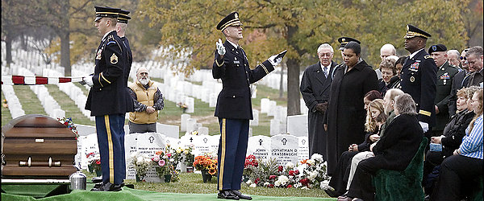
The Funeral MESSAGE
The Words We Use to Comfort, Care, & Honor
Notes:
Slide #2
Motivator:
Throughout your time as a Chaplain many of you have done Death Notifications, Memorial Ceremonies, Funeral Services, and have stood at the grave of a Soldier or family member and spoken a message of hope in the midst of despair, Grief, and loss.
Today we are going to pause and examine the words we use to comfort living, care for the wounded, and honor the Fallen.
Take a moment and look at the photo. What stands out to you? What do you notice? Think about the various levels of context made up in the gathering at the grave.
Take a moment and reflect then we discuss as a group.
Instructor note: Option to play music to help class reflect. This will add emotion to the discussion so think through the song and use what is most appropriate to group dynamics.
*Band of Brothers main theme by Michael Kamen
*Dress Blues by Zac Brown
*Arlington by Trace Adkins

Slide 3
Terminal Learning Objective (TLO)
ACTION: Analyze Elements of a Funeral Message
CONDITIONS: Given classroom environment, references, resources, time for discussion, practical exercises, and a rubric.
STANDARD: Analysis will include:
1. Discussion of experiences with funeral sermons
2. Comparison of funeral resources
Examine Parts and Flow of Grave Side Service
PE: Deliver a Funeral Message based on specific situation assigned.
Notes:
Slide #3 TLO

Slide 4
Administrative Data
Safety Requirements: NONE
Risk Assessment: LOW
Environmental Considerations: NONE
Evaluation: Analysis will include:
1. Discussion of experiences with funeral sermons
2. Comparison of funeral resources
Examine Parts and Flow of Grave Side Service
PE: Deliver a Funeral Message based on specific situation assigned.
Notes:
Slide #4 Admin Data

Slide 5
Chaplain’s Role
Whatever the event or location,
the chaplain’s primary role during military funerals, memorial services and ceremonies is to ensure the religious portion is performed or provided for with sensitivity to the religious and emotional needs of the Family and military unit of the deceased.
(ATP 1-05.02, Ch 1-5)
Notes:
Slide #5
There are lots of things that we do when honoring the dead.
But what is primary or most important?
Another way of looking at it is asking? What is the thing that no one else can do?
ATP 1-05.02 Religious Support to Funeral and Memorial Ceremonies and Services

Slide 6
Honoring the Fallen
1. Memorial Ceremony
Command responsibility; patriotic in nature, attendance may or may not be mandatory
2. Memorial Service
Sensitive to Service members faith; attendance is voluntary
3. Military Funeral
A. Chapel Service followed by movement to grave
B. Graveside Service only
Notes:
Slide #6
Here is a review to see the 3 primary was we serve. Today we are going to focus on the 3rd we will look at both aspects and then look at a model and PE to specifically address 3B. The Full Graveside Service.
Each of us will be doing more and more of these as we are in garrison. There are a few key reasons I believe that we will find ourselves doing more and more Graveside services. 1) They are building more Veterans Cemeteries around the country specifically near military bases. More and more vets are disconnected from Churches and families will request a chaplain. Supporting those who have served is an honor and yet can be overwhelming with a lack of information about the deceased and a short window of time to prepare. So today we will share experiences and best practices regarding performing Funeral services.

Slide 7
Crafting the Funeral Message
It doesn’t have to be original,
but it must be personal.
What we say matters.
How we say it matters.
The situational context matters.
Notes:
Slide #7 Bottom Line emphasis for Crafting The Funeral Message
It doesn’t have to be original, but it must be personal.
What we say matters.
How we say it matters.
The situational context matters.
Ask: What do you think about these statements?
What do you think the Line in bold means?
What is the difference between being original and personal?
Explain: The key to a speech or sermon is often to say something new. Analyzing the context of a passage and audience you are speaking to.
The funeral is different in that we must be attune to situational and personal dynamics. By tuning in and adding personal touches will build rapport audience, comfort to family and provide honor to the service member.

Slide 8
Resources
ATP 1-05.02 Religious Support to Funerals and Memorial Ceremonies and Services, 2013.
Chaplain Corps Digital Reference IMI ATP 1-05.02
Unit SOPs (Garrison, DIV, BN)
Dignity with Brevity: A Concise Guide to Crafting Christian Funeral Services edited by CH Fisher
Honor the Fallen: A Chaplain’s Guide compiled by CH Moore and CH Maddison
Notes:
Slide #8 LSA 2 Comparison of funeral resources
Take a look at various resources
Hold up examples and walk through.
Many of the Chaplain’s have not seen the IMI, Dignity with Brevity, and they should each have a copy of Honor the Fallen and a resource disk.
Walk through resources and explain. I may be helpful to show how they IMI works and show various resources in Dignity with Brevity.
Close by Walking through the “Honor the Fallen” Binder
Hand out example of Funeral Honor Request form and have students turn to HtF pages 4-7 to see the example Interview Cheat Sheet to help them shape the information of for the decedent.
Next walk through and explain other aspects of the book. Skip to section 2 laying out a funeral and graveside. Let them know that you will look at section 1 graveside only in more detail.

Slide 9
Other Resources
The Hardest Sermons You’ll Ever Have to Preach
by Bryan Chapel, 2011.
Accompany Them with Singing: The Christian Funeral
by Thomas G. Long, 2009.
A Contemporary Handbook for Weddings and Funerals and other Occasions by Aubrey Malphurs and Keith Willhite ed., 2003.
What can we learn from each other?
Manuals/Books
Situational Advice
Quotes, Poems, Music
Notes:
Slide #9
Other books that may be helpful
The Hardest Sermons You’ll Ever Have to Preach
by Bryan Chapel, 2011.
Accompany Them with Singing: The Christian Funeral
by Thomas G. Long, 2009.
A Contemporary Handbook for Weddings and Funerals and other Occasions by Aubrey Malphurs and Keith Willhite ed., 2003.
Ask students to think about various ways we can learn from each other.
Break into small groups and discuss: What are Books, resources, situational advice you would give to the class?
Give groups 5 min and call back together to share ideas. List on whiteboard if available.

Slide 10
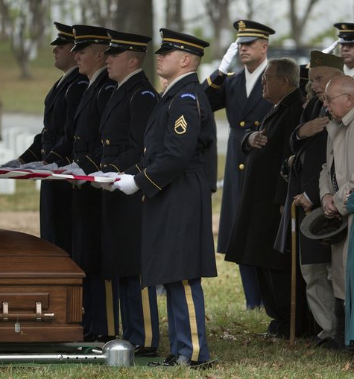
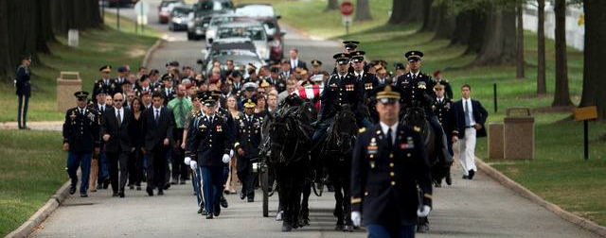
Introduction of Funeral SME
Former Chaplain at ANC
CH Ted Randall
Apr 2013-June 2015
Performed 857 services
Notes:
Slide 10: Student Resource
In the past we have students and faculty Funeral SME’s
We have had the Four CH’s below as students who added insight and some students who had a follow one assignment to ANC.
CH Ronnie Fisher
CH Scott Kennaugh
CH Matt Madison
CH Ted Randall
Ask students to share experiences with class and if available and time allows bring in someone to share experiences and expertise with class.

Slide 11
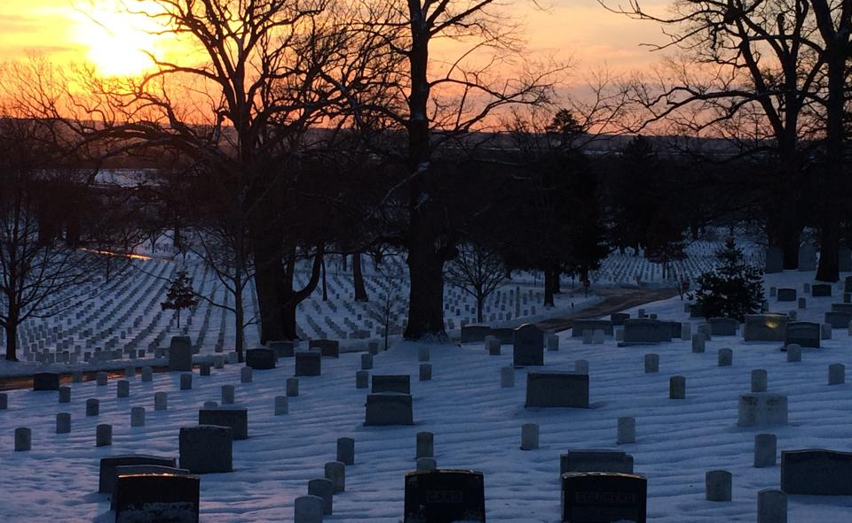
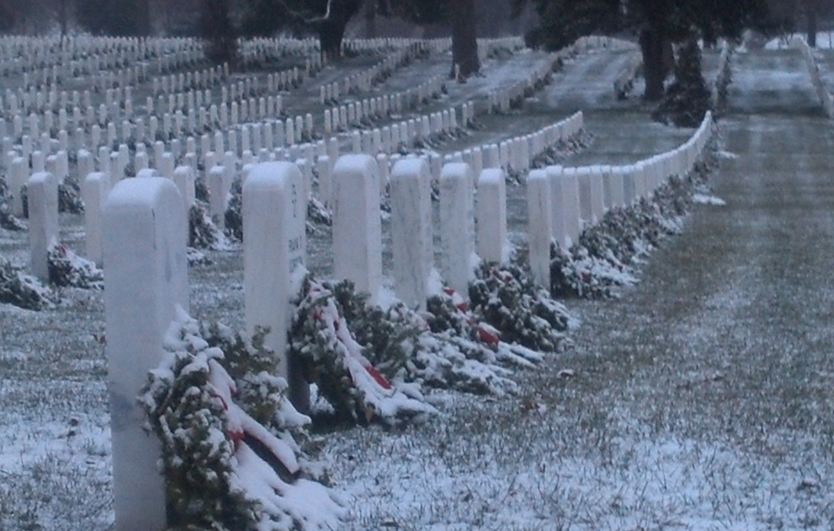
Graveside service
Notes:
Slide #11 LSA 3: Examine Parts and Flow of Grave Side Service
Have students turn to Section 1: Graveside Template & Example Graveside Only
Honor the Fallen Pages 10-16
Walk through outline p 10
Explain Graveside Template p. 11-13
Read through and discuss Example P 14-16

Slide 12
Final Tribute
Each final tribute draws from our
national, military and religious traditions and adds to it,
not routinely nor impersonally,
but profoundly and with compassion.
(ATP 1-05.2, C1-8)
Notes:
Slide #12 As you think off all we do, look at the layers of context
-National (Flag)
-Military (Taps and firing)
-Religious (Rites, Prayers, Scriptures)
What do you think the last line means?
Not routinely, nor impersonally, but profoundly and with compassion.

Slide 13
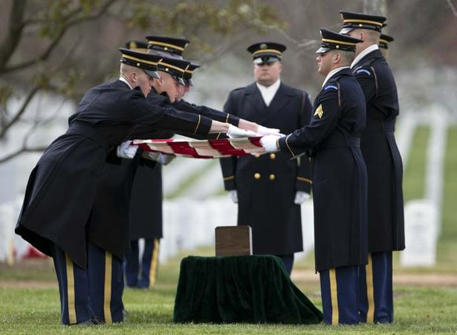

Folding & Presentation of the Flag
Notes:
Slide #13 Reflect on the importance of honors and all we do.
Pass out the Rubric, explain the assignment and explain how Dignity with Brevity (DWB) will be a great resource to flesh out the five parts if the Graveside service. The next few slides will highlight key points for each section and pages to look in DWB.

Slide 14
Introduction
A greeting of the day: “Good morning/Good afternoon”
A personal introduction: “My name is…”
A welcome introducing and/describing the setting as seen through the eyes of the minister: “Welcome to. .” or “These hallowed stones. . .”
Each closes with an opening prayer: “Please join me in prayer or let us pray.”
Each also serves to captivate the attention of those present.
Dignity With Brevity (DWB) 11-18
Notes:
Slide #14 Introduction
Point out section C on Rubric and SWB Pages 11-18

Slide 15
Opening Prayer
Points to consider in opening prayer
Who is prayer addressed to? Be specific.
What are you requesting?
Is there a biblical affirmation and truth expressed through your prayer?
What core truths and convictions are you communicating to those who may not be praying with you but rather listening to your prayer?
DWB p. 19
Notes:
Slide #15 Opening Prayer
Point out section D on Rubric and SWB Pages 19

Slide 16
Message- Personal (The Eulogy)
What personal remarks are appropriate?
How much should I discuss about the decedent’s life, past accomplishments, trade, career, aspirations, and the like?
Points of Interest
How long was the decedent married? (if applicable)
What kind of person was the decedent?
What did he/she stand for and/or value in life?
What will the decedent be remembered for most?
Was he/she a Christian?
DWB p. 20-29
Notes:
Slide #16 Message- Personal (The Eulogy) Section E Rubric
What personal remarks are appropriate?
How much should I discuss about the decedent’s life, past accomplishments, trade, career, aspirations, and the like?
Points of Interest
How long was the decedent married? (if applicable)
What kind of person was the decedent?
What did he/she stand for and/or value in life?
What will the decedent be remembered for most?
Was he/she a Christian?
Point out section E on Rubric and DWB Pages 20-20 Also See HtF page

Slide 17
Message- Religious (The Homily)
How will you craft your message?
Center on Text, Theme, or Perceived Need.
What are your ‘Go-to’ Passages, Poems, or Quotes?
Explain concept of a “Flip” in DWB.
Not a sermon as much as Scripture and transition
-DWB 30-32 and HtF: ACG 34-38
Notes:
Slide #17 Message- Religious (The Homily) Section F Rubric
How will you craft your message?
Center on Text, Theme, or Perceived Need.
What are your ‘Go-to’ Passages, Poems, or Quotes?
Explain concept of a “Flip” in DWB.
Not a sermon as much as Scripture and transition
-DWB 30-32 and HtF: ACG 34-38
Point out section E on Rubric and SWB Pages 20-20

Slide 18
Committal Prayer with trans. to Honors
How will you end the service and transition to honors?
Trans: Today we gather to remember, to honor and say Goodbye to “Name.” Good Bye for now.
Let us pray.
“Prayer . . . We commend to the Almighty God our brother “Name” and we commit his body to the ground. Earth to earth, ashes to ashes, dust to dust. Amen
For our comrade in arms, “Name” ,our nation bestows military honors. In life he/she honored the flag, and in death the flag with honor him/her.”
DWB 33-37
Notes:
Slide: 18: Committal Prayer with trans. to Honors Section G Rubric
1: How will you end the service and transition to honors?
Trans: Today we gather to remember, to honor and say Goodbye to “Name.” Good Bye for now.
Let us pray.
2: “Prayer . . . We commend to the Almighty God our brother “Name” and we commit his body to the ground. Earth to earth, ashes to ashes, dust to dust. Amen
3: For our comrade in arms, “Name” ,our nation bestows military honors.
In life he/she honored the flag, and in death the flag with honor him/her.”
DWB 33-37

Slide 19
Situational considerations
How does the context and situation shape the dynamics of the service and message?
What changes?
What does not change?
Notes:
Slide #19 Situational considerations
How does the context and situation shape the dynamics of the service and message?
It doesn’t have to be original, but it must be personal.

Slide 20
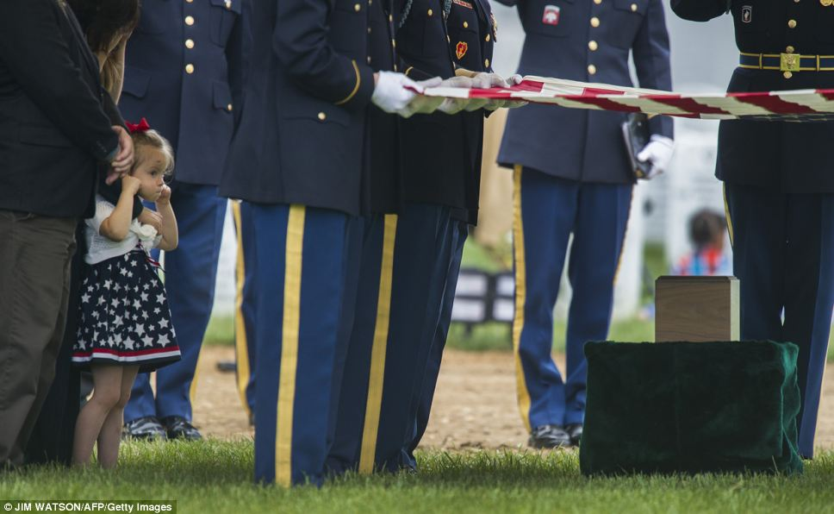
Remembering the Fallen
& Those left behind
Notes:
Slide #20 Hand out Scenarios
Explain That each one is difficult and different. If one is too personal a student can turn in for another different option. If there are questions regarding information a student can ask instructor as if they are the family and the funeral home. Note: Students should not add to or make up details with there scenario.

Slide 21
Putting it all together
Present a 5 min Graveside service
Given Rubric and Specific Decedent Scenario
Provide peer feedback on service
DTG and Location TBD
Questions?
Notes:
Slide #21 Each student will adequately prepare and conduct a Graveside Funeral Service based on a specific situation assigned and receive a GO (IAW a rubric) total of 100 pts.
Present a 5 min Graveside service
Given Rubric and Specific Decedent Scenario
Provide peer feedback on service
DTG and Location TBD
Any questions concerning the rubric, the assignment, or the scenarios?
Instructor Note: Make sure that students have at least a week before presenting funeral messages.
Plan for 5 min for each student and 3-5 min for comments and feeback

Slide 22
Check on Learning
What are some resources for help with funeral services?
What are the elements of a graveside service?
What is something you learned today?
When will you perform your graveside service?
Notes:
Slide #22 Check on learning
What are some resources for help with funeral services?
All that were handed out, other students, SGL, and instructors
What are the elements of a graveside service?
Intro, Prayer, Message, committal prayer and trans to honors
What is something you learned today?
When will you perform your graveside service?

